Slide 1


JLab 12 GeV Nucleon Structure Overview
Rolf Ent
(JLab 12 GeV Nuclear Overview Tomorrow)
12 GeV Upgrade – short
12 GeV Science – nucleon structure
- spectroscopy
- large x
- form factors
- transverse spatial and momentum imaging
- parity-violation at JLab
Backup: Approved 12 GeV Experiments
Hall Equipment
Hall Status
Hall Generic Science

Slide 2
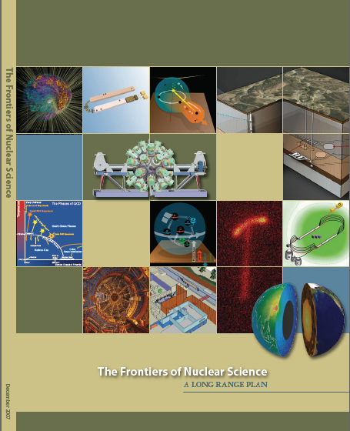
12 GeV Upgrade Project
Upgrade is designed to build on existing facility: vast majority of accelerator and experimental equipment have continued use
New Hall
Upgrade arc magnets
and supplies
Add 5 cryomodules
20 cryomodules
CHL upgrade
Maintain capability to deliver lower pass beam energies: 2.2, 4.4, 6.6….
Add arc
20 cryomodules
The completion of the 12 GeV Upgrade of CEBAF was ranked the highest priority in the 2007 NSAC Long Range Plan.
Add 5 cryomodules
Scope of the project includes:
Doubling the accelerator beam energy
New experimental Hall and beamline
Upgrades to existing Experimental Halls
Enhanced capabilities
in existing Halls

Slide 3
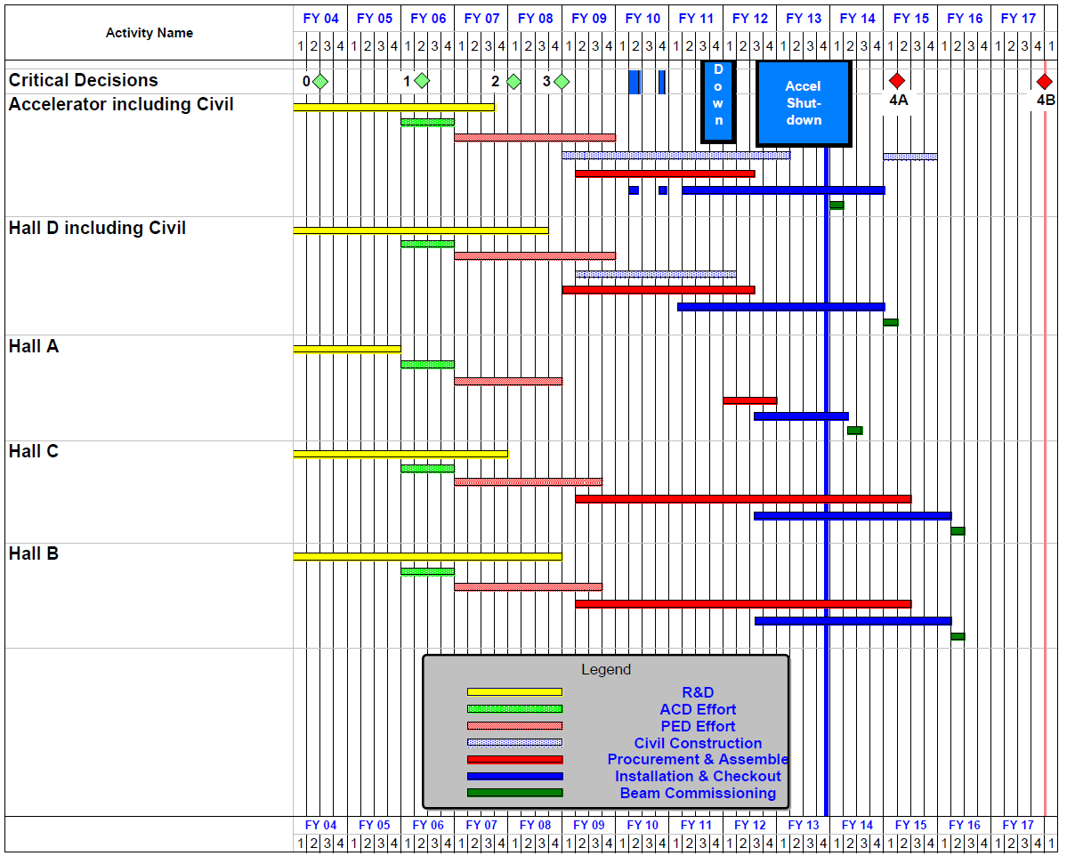
12 GeV Upgrade Project Schedule
FY12: reduction of $16M
FY13: Pres Request – no restoration
    16-month installation
    May 2012 - Sept 2013
    Accelerator commissioning start Oct 2013
    Hall A commissioning start Feb 2014
    Hall D commissioning start
    Oct 2014
    Halls B & C commissioning start Jan/Feb 2016
    Project Completion September 2017
Re-baseline Approved
September 4, 2013

Slide 4
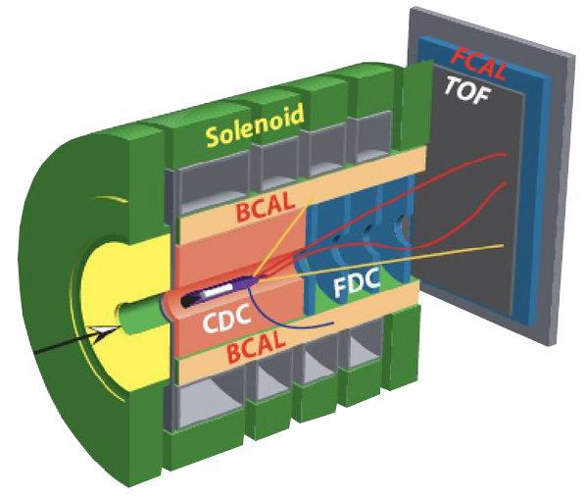
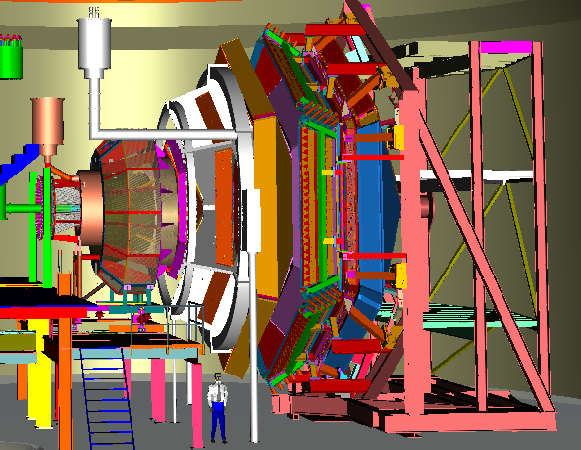
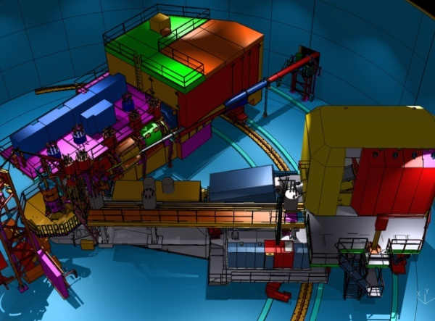

12 GeV Upgrade Physics Instrumentation
GLUEx (Hall D): exploring origin of confinement by studying hybrid mesons
CLAS12 (Hall B): understanding nucleon structure via generalized parton distributions
SHMS (Hall C): precision determination of
valence quark properties in nucleons and nuclei
Hall A: nucleon form factors,
& future new experiments like Moller & SOLID
Notes:
Note BSM not included in project

Slide 5
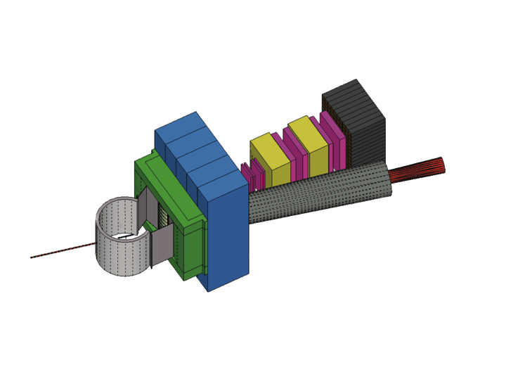
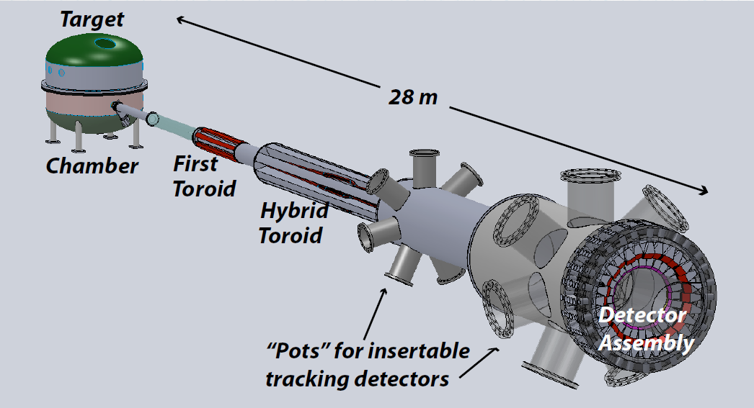

Beyond 12 GeV Upgrade
Super BigBite Spectrometer
(Approved for FY13-16 construction)
- high Q² form factors
- SIDIS
MOLLER experiment
(MIE – FY15-19?)
- Standard Model Test
SoLID program
Chinese collaboration
CLEO Solenoid

Slide 6
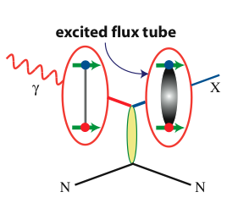
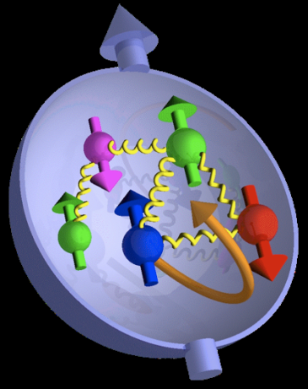

21st Century Science Questions
What is the role of gluonic excitations in the spectroscopy of light mesons?
Where is the missing spin in the nucleon?
What is the role of orbital angular momentum?
Can we reveal a novel landscape of nucleon substructure through measurements of new multidimensional distribution functions?
What is the relation of short-range nuclear structure and parton dynamics?
Can we discover evidence for physics
beyond the standard model
of particle physics?
Excited Glue

Slide 7
Meson Spectroscopy: the future
Excited
Gluon Field
Quarks
Hybrid Meson
like
Exotic
like
Gluonic excitation (and parallel quark spins) lead to exotic J^{PC}

Slide 8
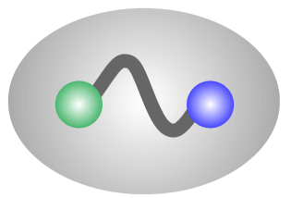
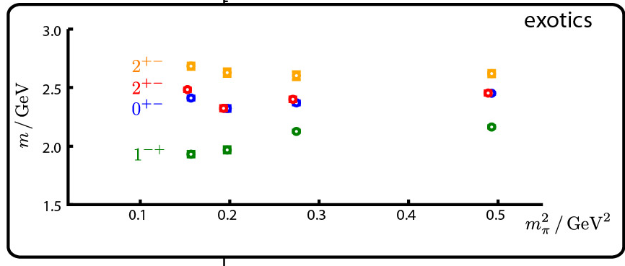
Gluonic Excitations and the mechanism for confinement
QCD predicts a rich spectrum of as yet to be discovered gluonic excitations - whose experimental verification is crucial for our understanding of QCD in the confinement regime.
With the upgraded CEBAF, a linearly polarized photon beam, and the GlueX detector, Jefferson Lab will be uniquely poised to: - discover these states,
- map out their spectrum, and
- measure their properties
q
_
q
Dudek et al.
States with Exotic Quantum Numbers
q
q
γ
beam
before
after
q
q

Slide 9
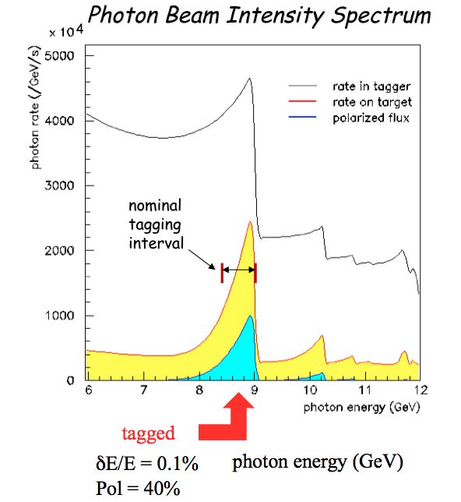
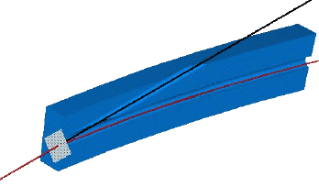
Hall D Strategy: Coherent Bremsstrahlung
Use 8-9 GeV polarized photons
(12 GeV electron beam)
Use hermetic detector
with large acceptance
Perform amplitude analysis
photons out
electrons in
spectrometer
diamond
crystal
This technique provides requisite energy, flux and polarization (gain of 10,000 versus existing photo-production data)
Notes:
40 % polarization - truncate 1t 11.5 GeV -
Note the discussion about upper energy

Slide 10
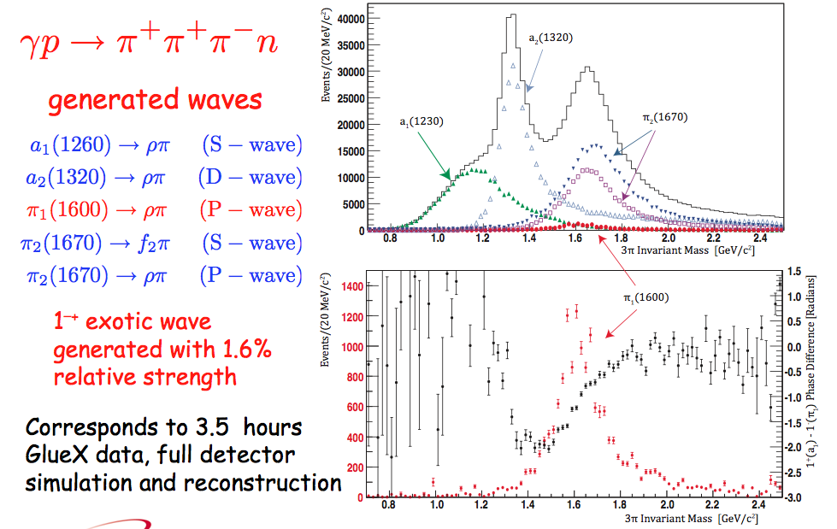
Sample Amplitude Analysis with Gluex

Slide 11
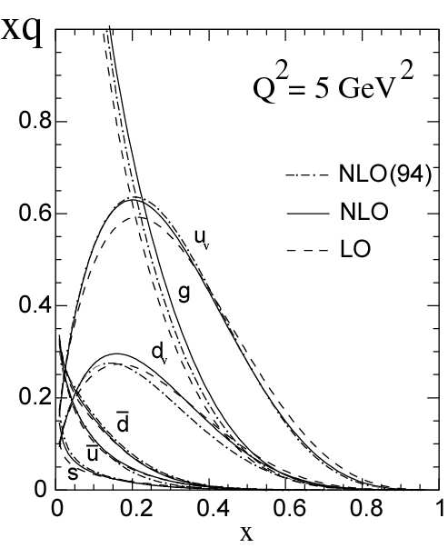
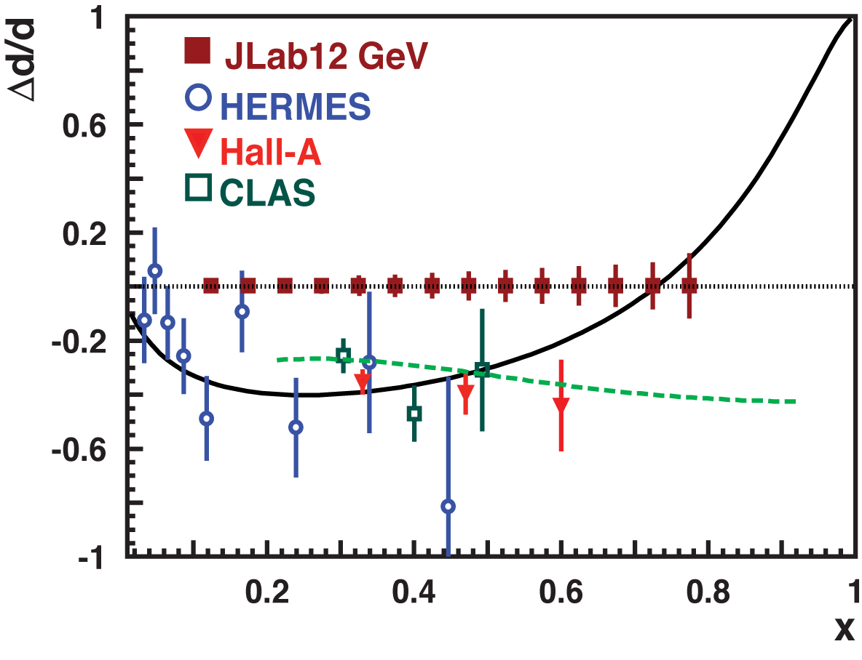
Measuring High-x Structure Functions
REQUIRES:
High beam polarization
High electron current
High target polarization
Large solid angle spectrometers
BONUS
3H/3He
PVDIS
12 GeV will access the regime (x > 0.3), where valence quarks dominate

Slide 12
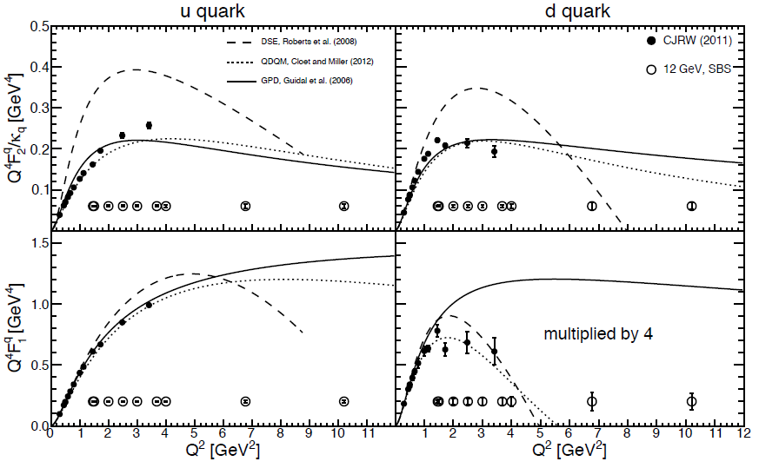
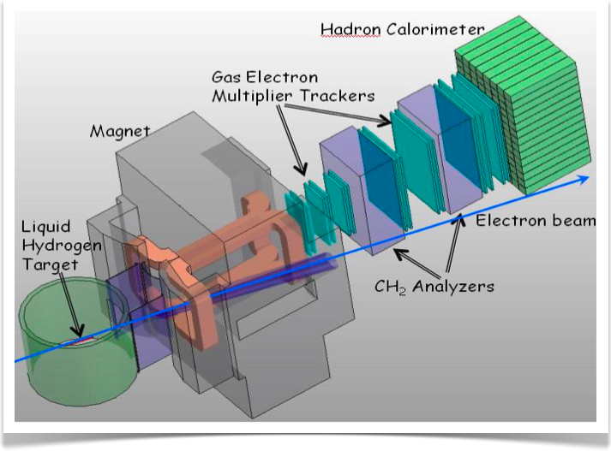
Measuring Elastic Form Factors – add SBS
Physics Reach of the Super BigBite Spectrometer (SBS) in Hall A:
Electromagnetic Form Factors at high Q²
  Use high luminosity
  + open geometry
  + GEM detectors
  Pushes G_{E}^{p}/G_{M}^{p}, G_{E}^{n}, G_{M}^{n} to high Q²
  Allows for flavor decomposition to distance scales deep inside the nucleon
Semi-Inclusive Deep Inelastic Scattering
  Active program foreseen at 12 GeV in Halls A, B, C
  Approved SBS experiment provides precision data early on with transversely polarized ³He at large x and Q²
Possibly also other proposals

Slide 13
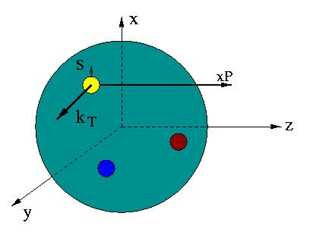

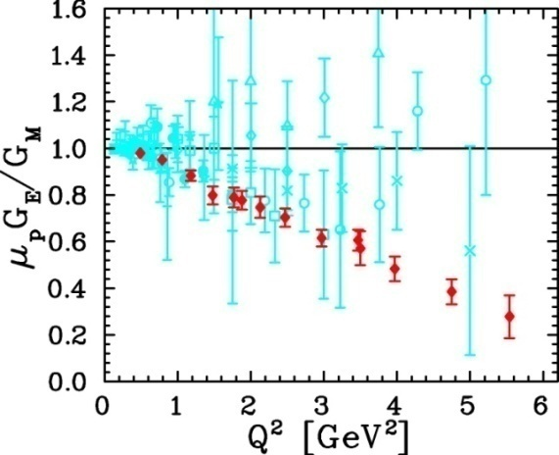
Unified View of Nucleon Structure
W_{p}^{u}(x,k_{T},r_{T}) Wigner distributions
5D Dist.
d²r_{T}
d²k_{T}
TMD PDFs f₁^{u}(x,k_{T}), .. h₁^{u}(x,k_{T})‏
GPDs/IPDs
3D imaging
dx &
Fourier Transformation
d²k_{T}
d²r_{T}
Form Factors
G_{E}(Q²),
G_{M}(Q²)‏
PDFs
f₁^{u}(x), .. h₁^{u}(x)‏
1D

Slide 14
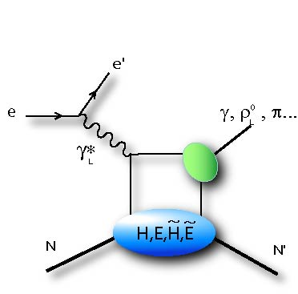
3D Parton Distributions: GPD
Q²
Longitudinal momentum fraction x at transverse location b
At leading twist eight GPDs whose extraction is possible ony through models/parameterizations ➔ needs data in a large kinematic domain of x_{B}, t, Q²
t
DVCS provides the cleanest process for accessing GPDs
Polarized beam, unpolarized target:
Unpolarized beam, longitudinal polarized target:
Unpolarized beam, transverse polarized target:
H(ξ,t)
~
H(ξ,t)
E(ξ,t)

Slide 15
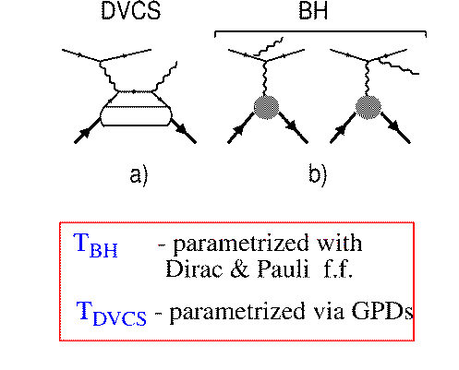
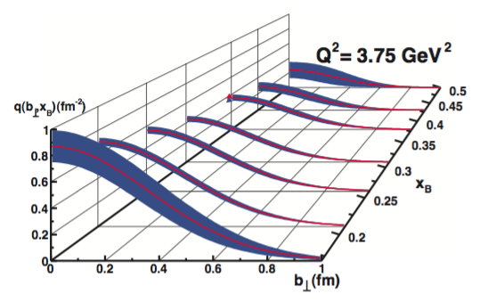
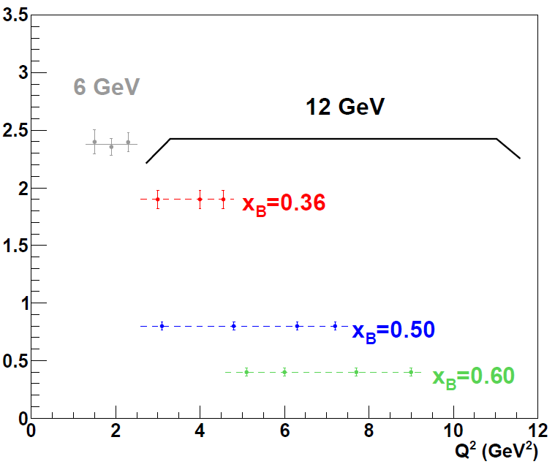
Towards the 3D Structure of the Proton
Simplest process: e + p → e’ + p + γ (DVCS)
DVCS
e
e
BH
Polarized beam, unpolarized target:
H(ξ,t)
~
Unpolarized beam, long. polarized target:
H(ξ,t)
p
p
Unpolarized beam, transv. polarized target:
E(ξ,t)
Hall A data for Compton form factor (over limited Q² range) agree with hard-scattering
Hall B beam-spin asymmetry data show potential for imaging studies from analysis in x, Q² and t
12 GeV projections: transverse spatial maps
12 GeV projections: confirm formalism
Im C’

Slide 16
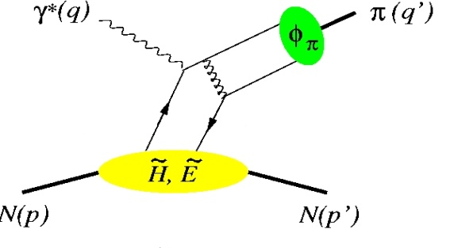
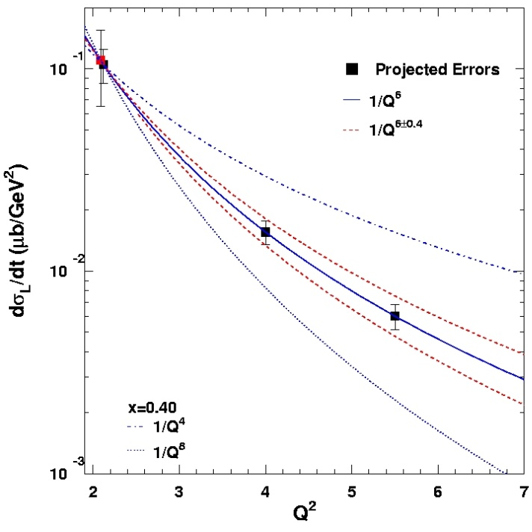
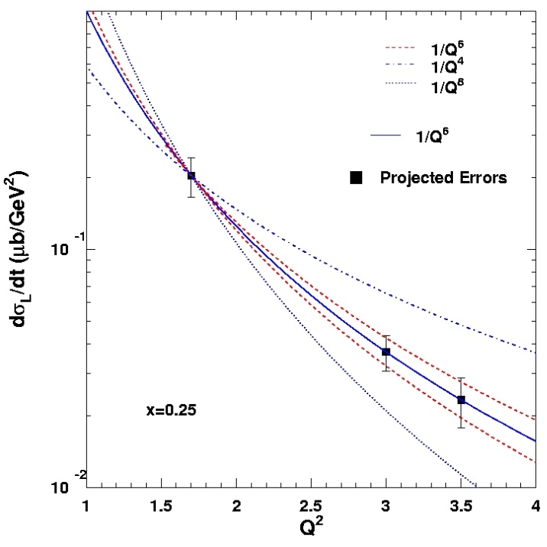
Factorization Tests in π⁺ and K⁺ Electroproduction
σ = Γ(σ_{Τ} + εσ_{L} + ε cos(2φ)σ_{TT} + [ε(ε+1)/2]^{1/2}cos(φ)σ_{LT})
π, K, etc.
p(e,e’π⁺)n
φ
Hard Scattering
Q⁻⁴
Fit: 1/Q^{n}
GPD
Q⁻⁶
Q⁻⁸
One of the most stringent tests of factorization is the Q² dependence of the π and K electroproduction cross section
  σ_{L} scales to leading order as Q⁻⁶
x_{B} = 0.40
p(e,e’K⁺)Λ
Q⁻⁶
Q⁻⁴
Experimental validation of factorization essential for reliable interpretation of results from the JLab GPD program at 12 GeV for meson electroproduction
Q⁻⁸
x_{B}=0.25
K and π together provide quasi model-independent study

Slide 17


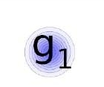
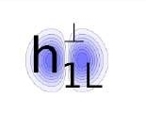

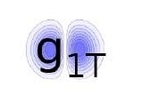
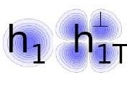
3D Parton Distributions: TMDs
Access orbital motion of quarks
➔ contribution to the proton’s spin
Observables: Azimuthal asymmetries due to correlations of spin q/n and transverse momentum of quarks
quark polarization
U
L
T
T
U
f₁
h₁
Boer-Mulders
nucleon polarization
g_{1L}
T
L
h_{1L}
helicity
worm-gear
Two major asymmetries:
Sivers: effect in distribution funct.
Collins: effect in fragmentation funct.
TMDs Accessible through Semi-Inclusive DIS (SIDIS) reactions
T
,
T
T
f_{1T}
g_{1T}
h₁
h_{1T}
Sivers
worm-gear
transversity
pretzelosity

Slide 18
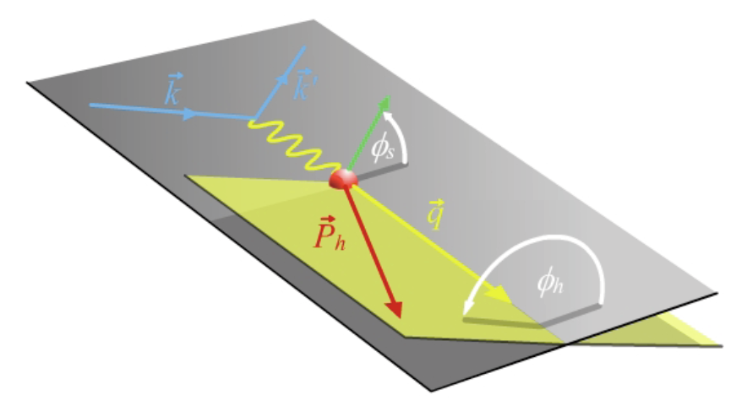
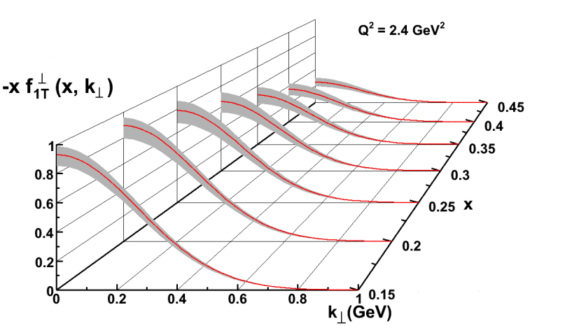
SIDIS Electroproduction of Pions
Separate Sivers and Collins effects
Sivers angle, effect in distribution function: (φ_{h}-φ_{s})
Collins angle, effect in fragmentation function: (φ_{h}+φ_{s})
Previous data from HERMES,COMPASS
New landscape of TMD distributions
Access to orbital angular momentum
target angle
hadron angle
Scattering Plane

Slide 19
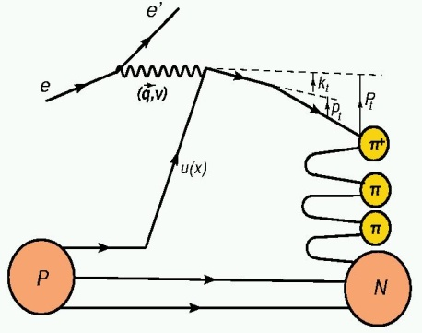
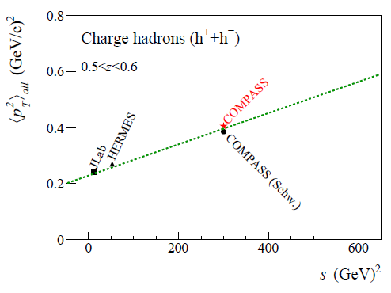
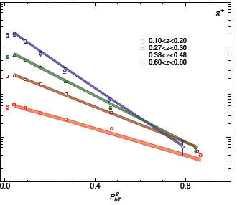
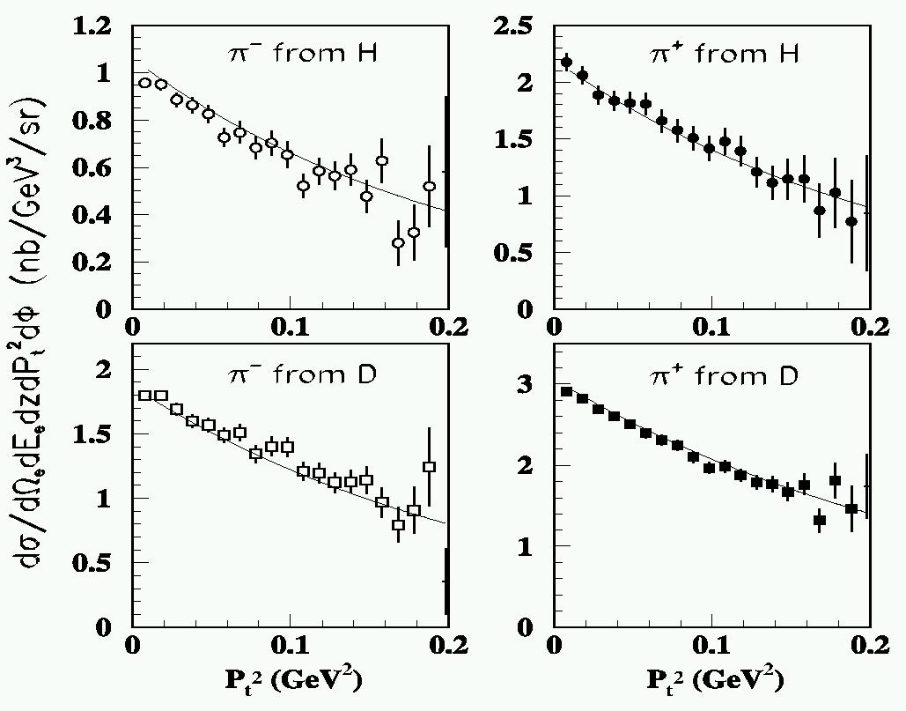
Transverse momentum dependence of SIDIS
Final transverse momentum of the detected pion P_{t} arises from convolution of the struck quark transverse momentum k_{t} with the transverse momentum generated during the fragmentation p_{t}.
P_{t} = p_{t} + z k_{t} + O(k_{t}²/Q²)
Intrinsic value of SIDIS to establish transverse momentum widths of quarks with different flavor and polarization now well established (and they can be different). Steps towards QCD evolution taken. Need precision at large z to validate fragmentation process, verify target-mass correction and ln(1-z) re-summation, etc. – To acquire precision data is the job of JLab-12!
Adolph et al., arXiv:1305.7317v1
Airapetian et al., PRD 107 (2013) 074029; Signori et al., arXiv:1309.3507
Mkrtchyan et al., PL B665 (2008) 20; Asaturyan et al., PRC 105 (2012) 015202
Example
COMPASS
HERMES
Hall C

Slide 20
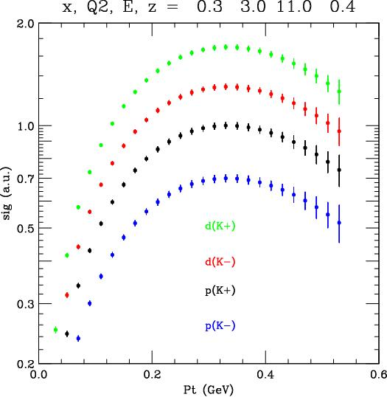
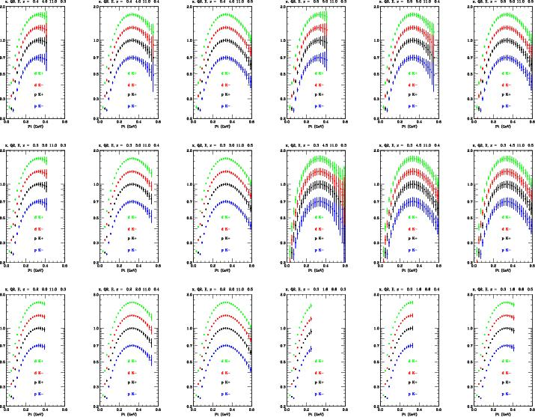
E12-09-017 Projected Results - Kaons
III
IV
II
VI
I
V

Slide 21
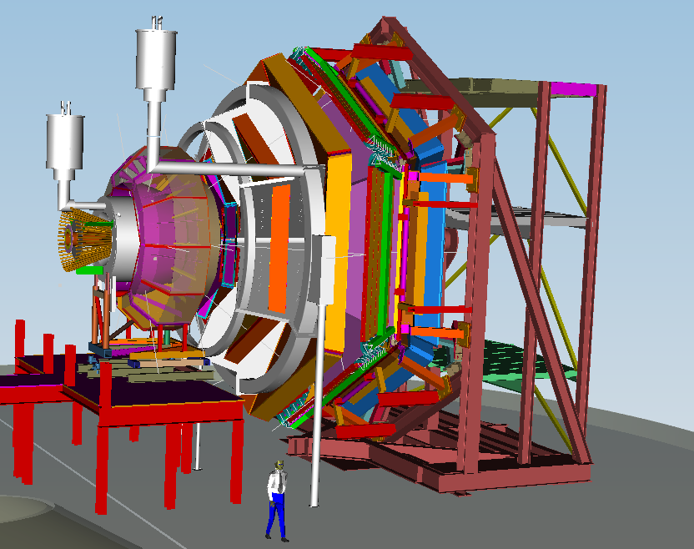
Together stronger: SIDIS Studies with 12 GeV
CLAS12 in Hall B
General survey, medium lumi
SHMS- HMS in Hall C
L-T studies, precise π⁺/π⁻ ratios
SBS in Hall A
High x, High Q², 2-3D
SOLID in Hall A
High Lumi and acceptance – 4D

Slide 22

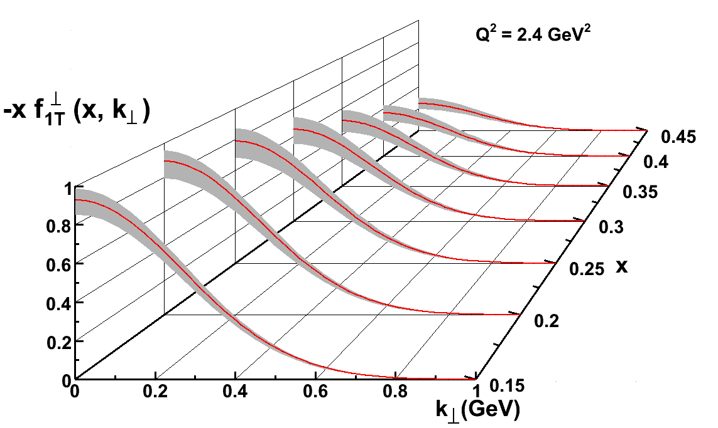
The Incomplete Nucleon: Spin Puzzle
1
1
ΔΣ
+
L_{q}
+
J_{g}
=
2
2
ΔΣ ~ 0.25 (world DIS)
ΔG small (RHIC+DIS)
L_{q}?
Longitudinal momentum fraction x and transverse momentum images
Longitudinal momentum fraction x and transverse spatial images
Up quark Sivers Function
12 GeV projections: valence quarks well mapped

Slide 23
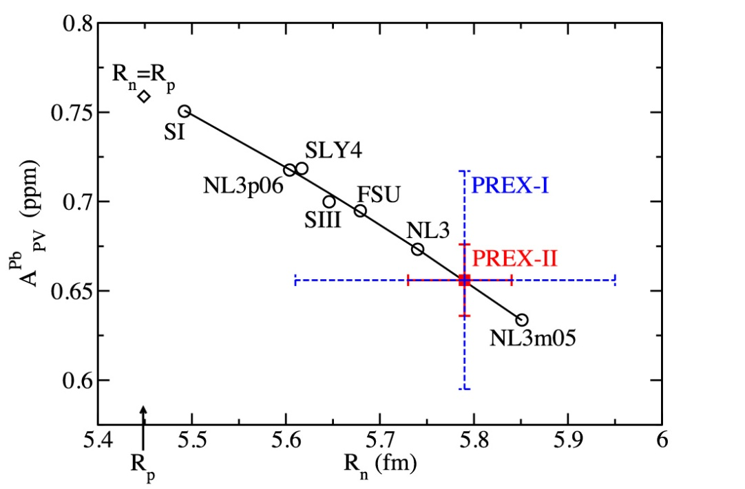
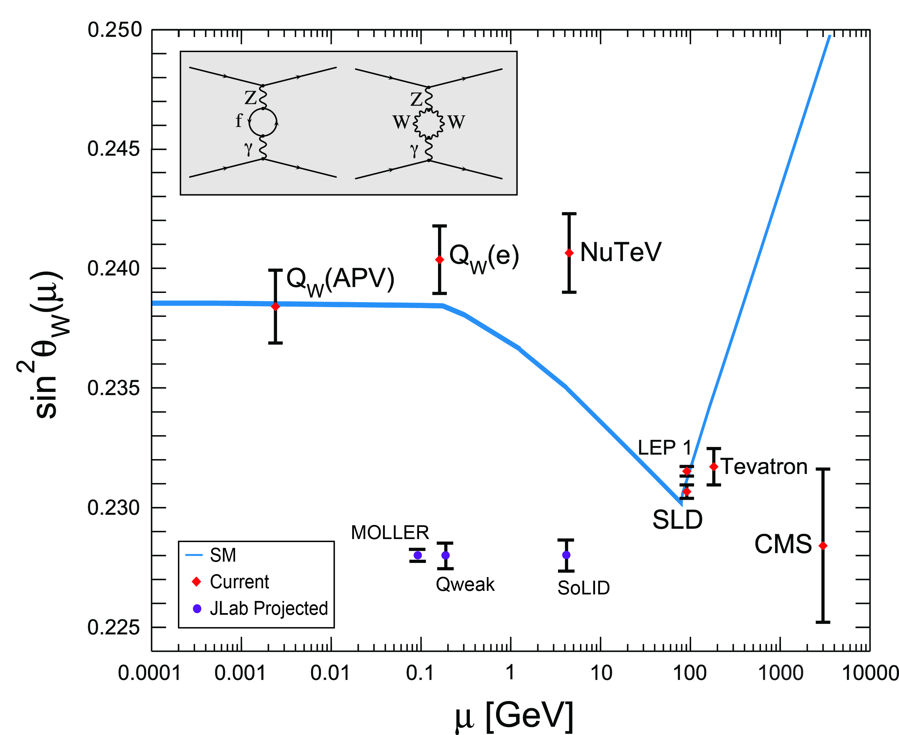
Parity Violation at JLab
Strangeness Form Factors (complete)
HAPPEX (Hall A)
G0 (Hall C)
PREX neutron skin
Qweak (under analysis)
proton weak charge
MOLLER
SoLID
  lepto-quark couplings
  d/u, higher-twist

Slide 24
12 GeV JLab – The Potential
Opportunity to discover and study new exotic mesons to elucidate the mechanism of confinement.
Open a new landscape of nucleon tomography, with potential to identify the missing angular momentum.
Establish the quantitative foundation for the short-distance behavior in nuclei, underpinning the development of precision nuclear structure studies.
Provide stringent new tests of the standard model and extensions, complementing the information obtained at LHC.

Slide 25
Backup: Approved 12 GeV Experiments
Hall Equipment
Hall Status
Hall Generic Science

Slide 26
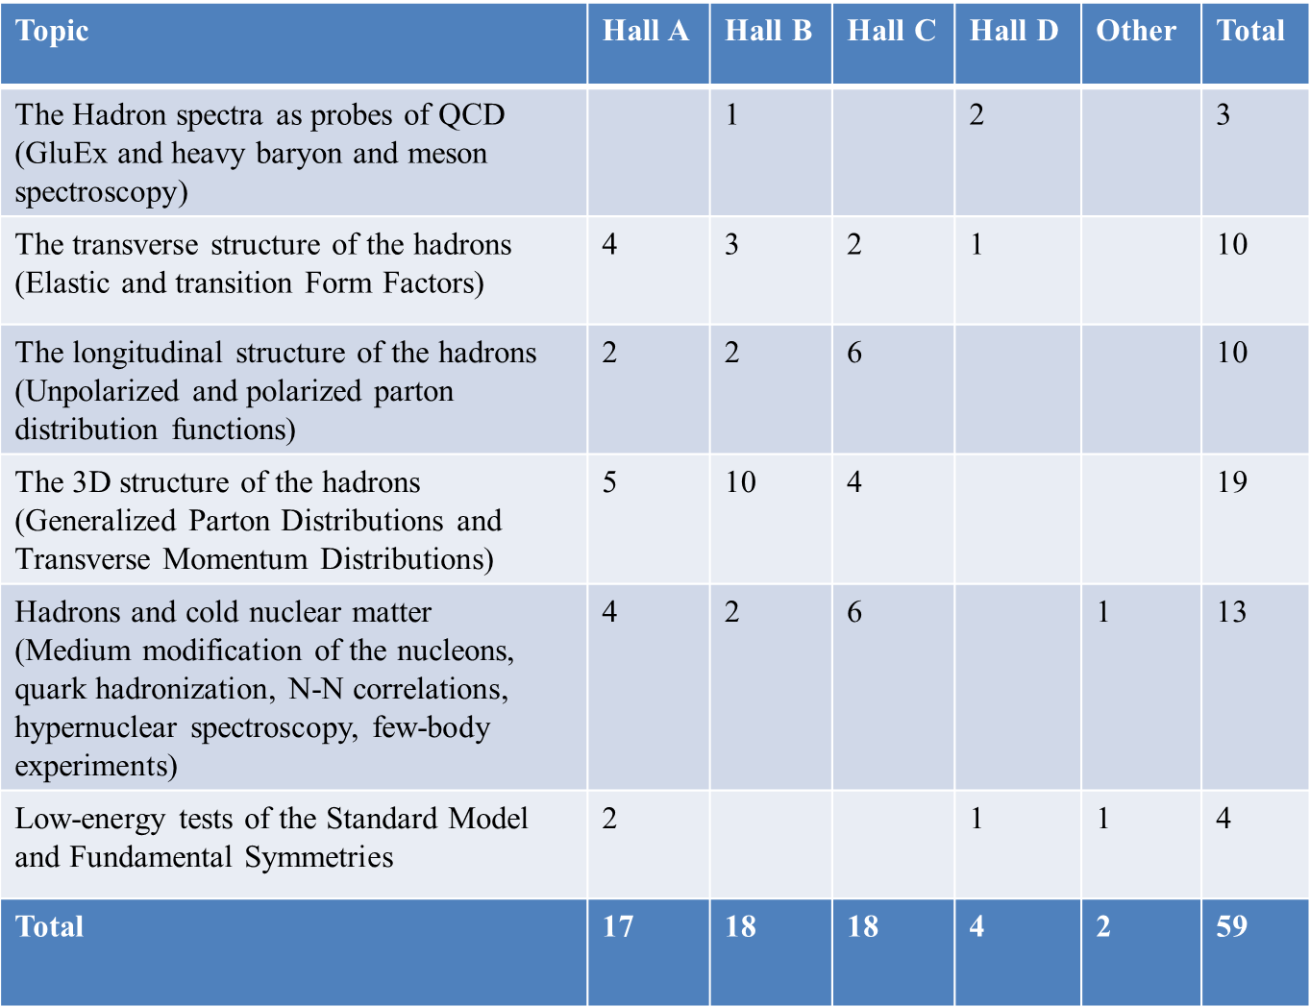
12 GeV Approved Experiments by Physics Topics
E12-11-105 has not been counted with the experiments since it was considered a test

Slide 27
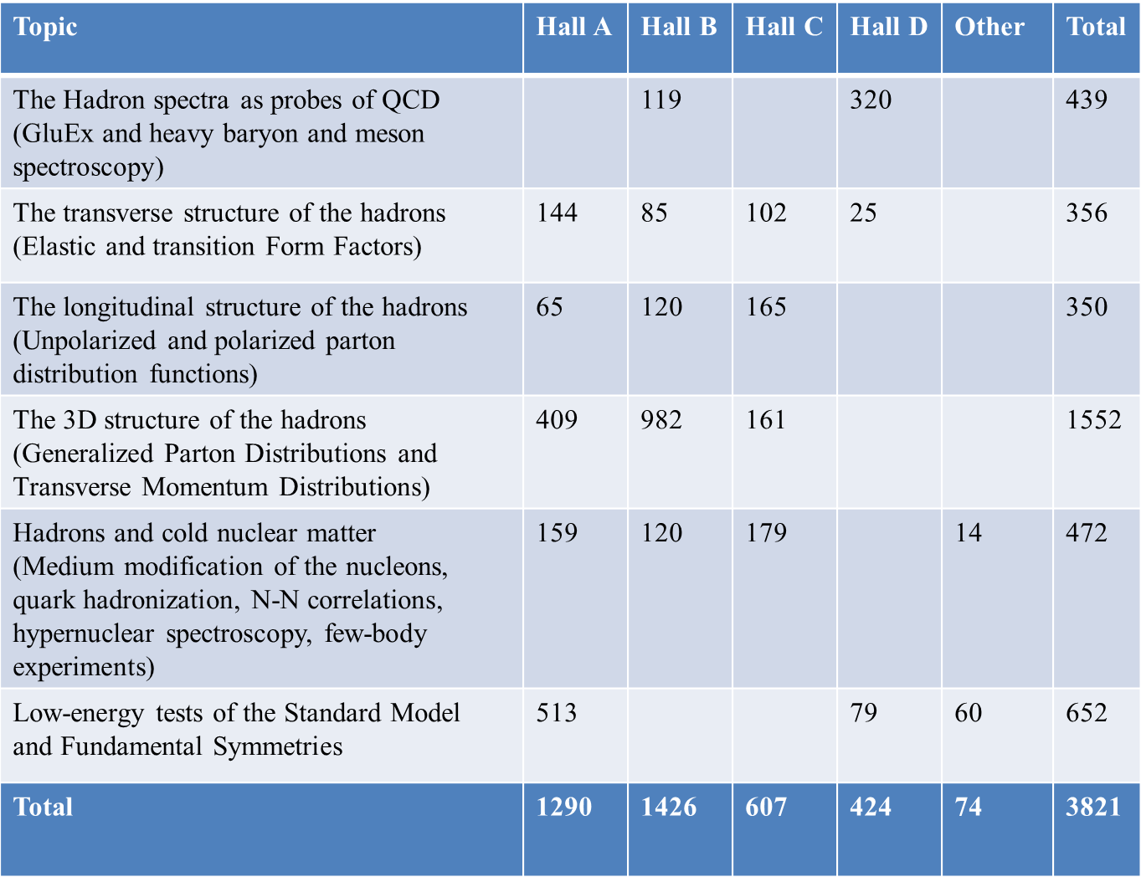
12 GeV Approved Experiments by PAC Days
More than 7 years of approved experiments

Slide 28
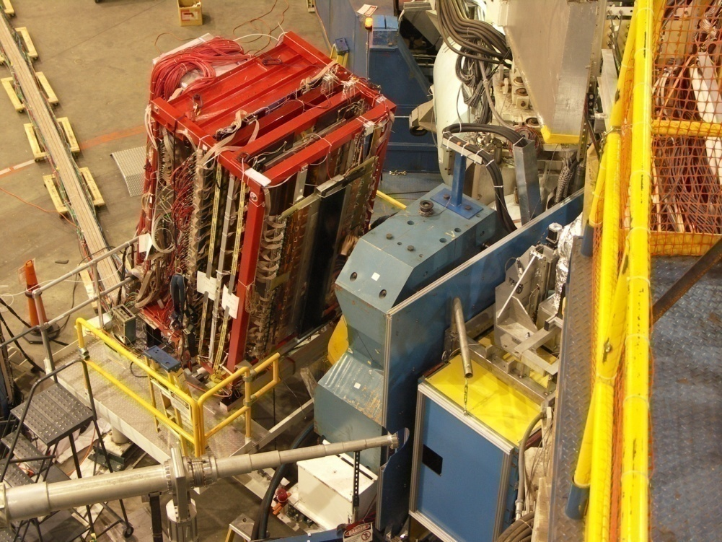
Hall A Equipment
Maintain HRS spectrometer pair
Add SBS spectrometer
(similar as BigBite spectrometer)
Moller & Compton Beam Polarimetry
SBS setup
HRS pair
Space for ancillary apparatus
BigBite setup
Successful review in Oct. 2011
DOE/NP approval Apr. 2012
Start of SBS Project Oct. 2012
DOE/NP annual review Nov. 2013
Future: MOLLER and SoLID

Slide 29
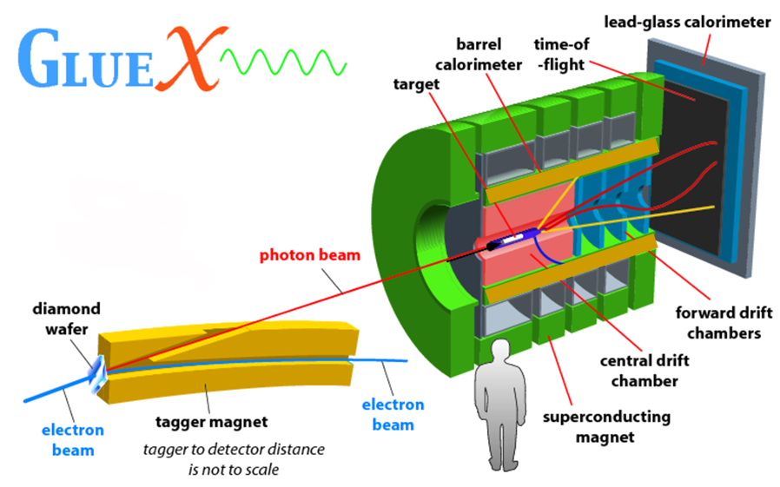
New Hall D – Photon Beam
FCAL
TOF
Excited Glue
BCAL
start counter
FDC
CDC
BCAL

Slide 30
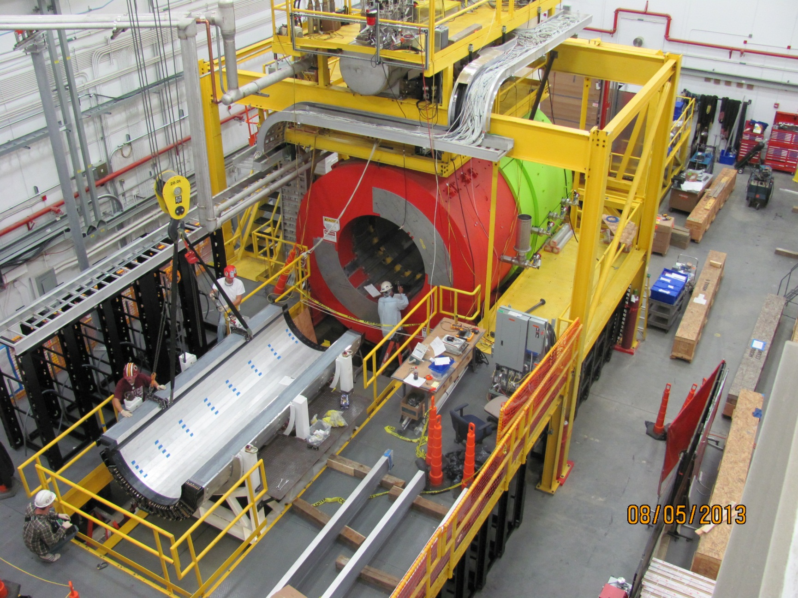
HALL D SOLENOID OPERATIONAL,
DETECTOR INSTALLATION IN PROGRESS
Now, two months later: BCAL installed, cabling ongoing. FCAL complete, FDC imminent.

Slide 31
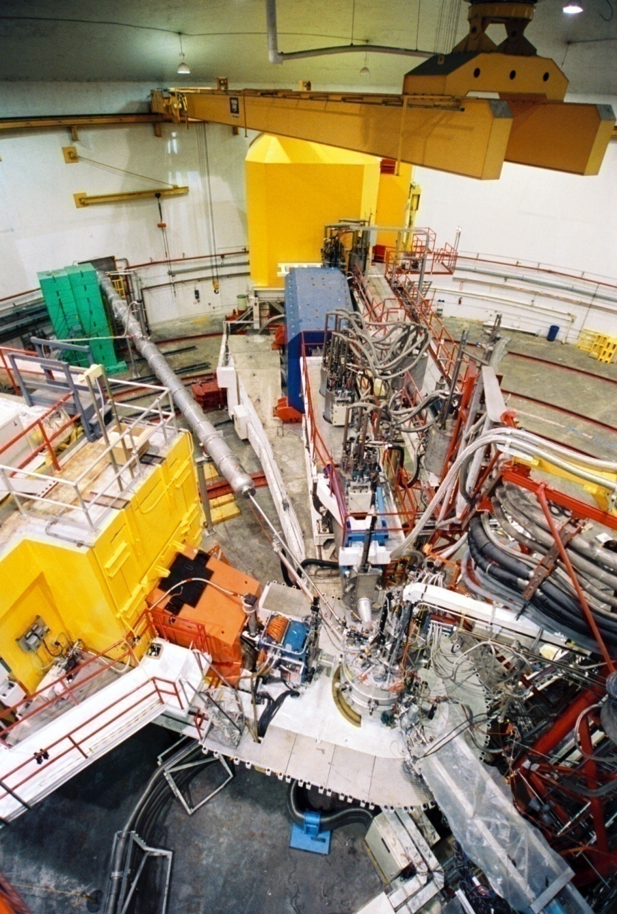
Hall C Equipment
Maintain HMS spectrometer
Remove SOS spectrometer
Add SHMS spectrometer
Hall C (SOS/HMS)
Hall C (SHMS/HMS)

Slide 32
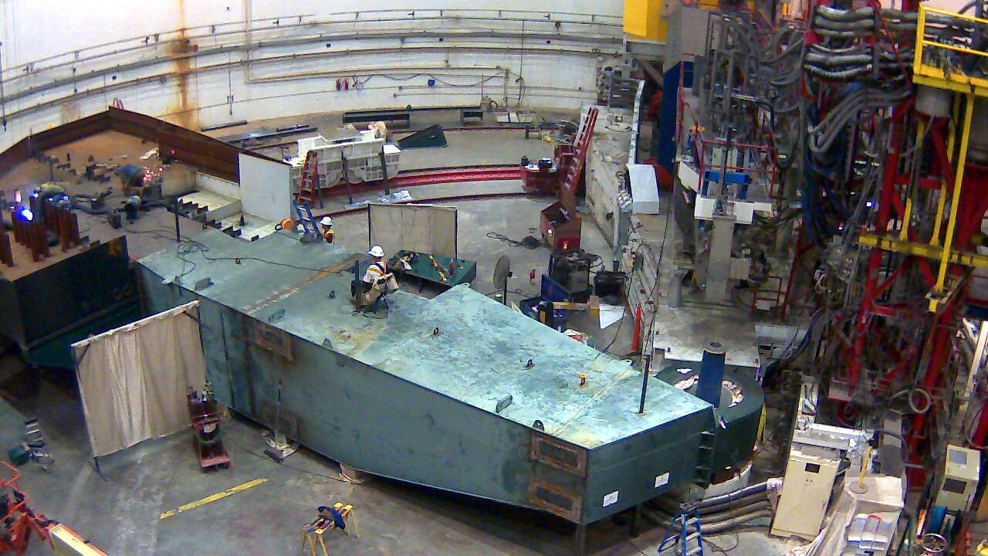
HALL C – STEELWORK COMPLETED
Shield House Construction Ongoing, Detectors near-completed.

Slide 33
Hall C at 12 GeV: HMS + SHMS
HMS is the same spectrometer between 0.5 and 5 GeV, and extremely well understood, e.g. highlighted by >200 Rosenbluth separations (close to 1,000 kinematics) performed to date. SHMS emulates the essential features of HMS, with angle reach down to 5.5º and central momentum up to 11 GeV/c.
Charged particle detection w. momentum up to beam energy z = E_{h}/ν = 1
Small angle capability essential to measure charged particle along momentum transfer θ_{h} // q ± few º
Precision L/T separations over range of x and Q²
High Luminosity and well-shielded detectors to access small (neutrino-level) nuclear cross sections L = 10³⁸
σ = Γ(σ_{Τ} + εσ_{L} + ε cos(2φ)σ_{TT} + [ε(ε+1)/2]^{1/2}cos(φ)σ_{LT})

Slide 34

Hall B Equipment
Remove CLAS detector
(recycle many components)
Add CLAS12 detector
Hall B (CLAS)
Hall B (CLAS12)

Slide 35

HALL B – STEELWORK NEARING COMPLETION
Multiple Detector construction projects ongoing, many well advanced.

Slide 36
Hall B at 12 GeV: CLAS12
Utilize multi-purpose large-acceptance device (CLAS12) with (polarized) electron beam and variety of polarized and unpolarized targets to access a broad science program:
Extensive program of Transverse Momentum Dependent and Generalized Parton Distributions
Proton and deuteron polarized and unpolarized structure functions
towards large Bjorken x (A₁^{p}, A₁^{d}, F₂^{d}/F₂^{p},d/u)
Neutron magnetic form factor (G_{M}^{n}) measurement up to high Q²
Hadronization and (ρ) Color Transparency Studies
Quasi-real low-Q² (hybrid) meson and baryon spectroscopy studies

