Slide 1
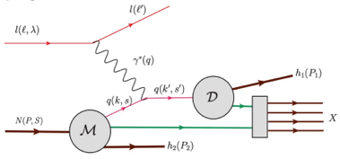
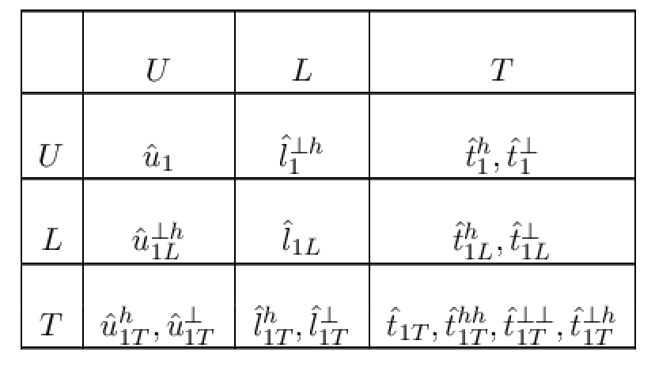
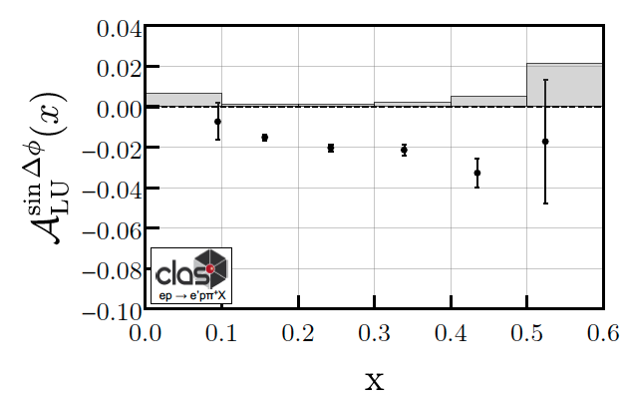
Correlations in Back-to-Back Dihadron Production
M. Anselmino, V. Barone and A. Kotzinian, Physics Letters B 713 (2012)
Fragmentation function q→π+
H. Avakian et al. (CLAS), Phys. Rev. Lett. 130, 022501 (2023)
Twist-2 table
(Fracture Functions)
p
N/q
Conditional probability to kick out a quark q with a proton produced in the remnant (Fragmentation Function)
SSA significant at large x, where the valence quarks (non-perturbative sea) dominate?
Correlation asymmetry is linked to Leading Twist(LT) distributions of longitudinally polarized quarks
First indication in large x SIDIS of a LT observable
Correlation between the struck quark and the remnant produces correlation between hadrons (entanglement)
Multidimensional measurements crucial for evolution studies

Slide 2
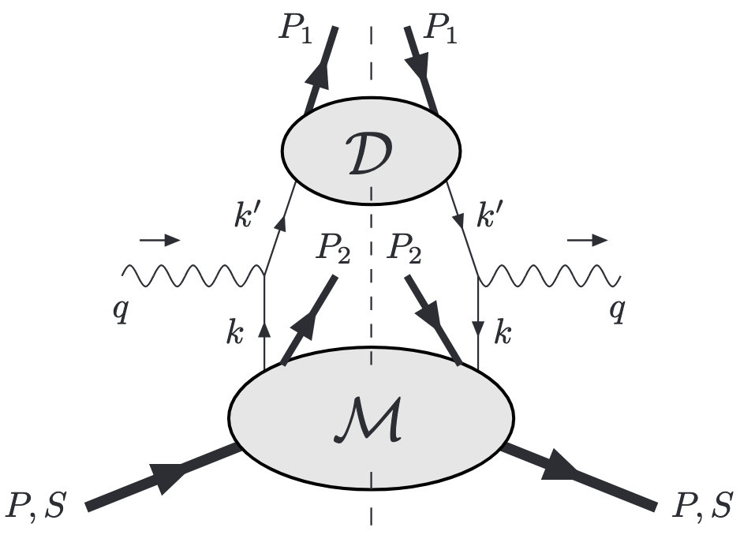
Correlations in Back-to-Back Dihadron Production
M. Anselmino, V. Barone and A. Kotzinian, Physics Letters B 713 (2012)
H. Avakian et al. (CLAS), Phys. Rev. Lett. 130, 022501 (2023)
Fragmentation function→π+
Twist-2 table
(Fracture Functions)
N/q
Conditional probability to kick out a quark with a proton detected in the remnant (Fragmentation Function)
SSA significant at large x, where the valence quarks (non-perturbative sea) dominate?
Correlation asymmetry is linked to Leading Twist(LT) distributions of longitudinally polarized quarks
First indication in large x SIDIS of a LT observable
Correlation between the struck quark and the remnant produces correlation between hadrons (entanglement)
Multidimensional measurements crucial for evolution studies

Slide 3
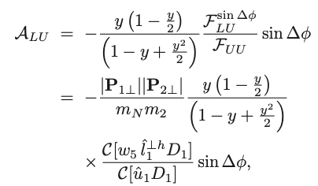
Correlations in Back-to-Back Dihadron Production
M. Anselmino, V. Barone and A. Kotzinian, Physics Letters B 713 (2012)
H. Avakian et al. (CLAS), Phys. Rev. Lett. 130, 022501 (2023)
Twist-2 table
(Fracture Functions)
N/q
correlation
modulation
SSA significant at large x, where the valence quarks (non-perturbative sea) dominate?
Correlation asymmetry is linked to Leading Twist(LT) distributions of longitudinally polarized quarks
First indication in large x SIDIS of a LT observable
Correlation between the struck quark and the remnant produces correlation between hadrons (entanglement)
Multidimensional measurements crucial for evolution studies

