Slide 1
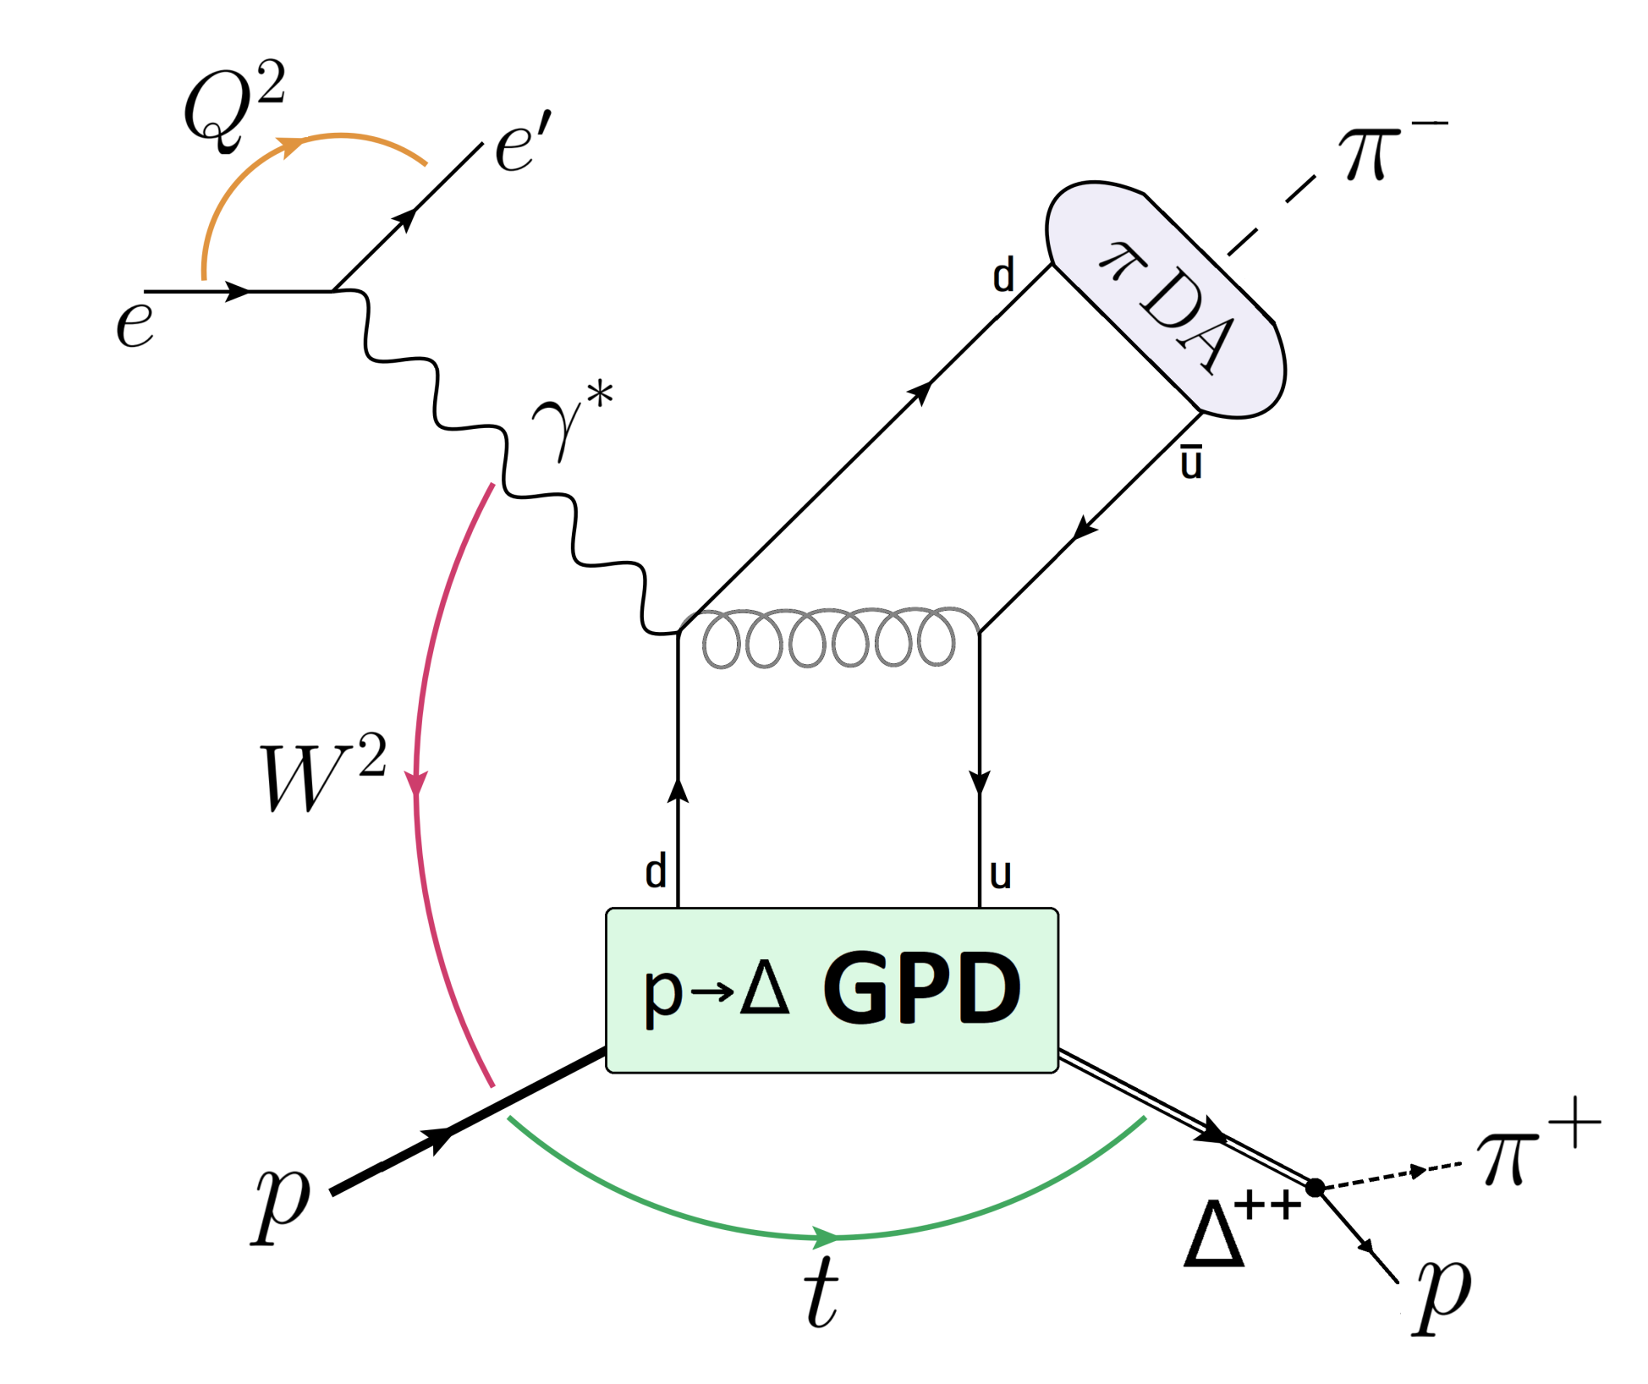
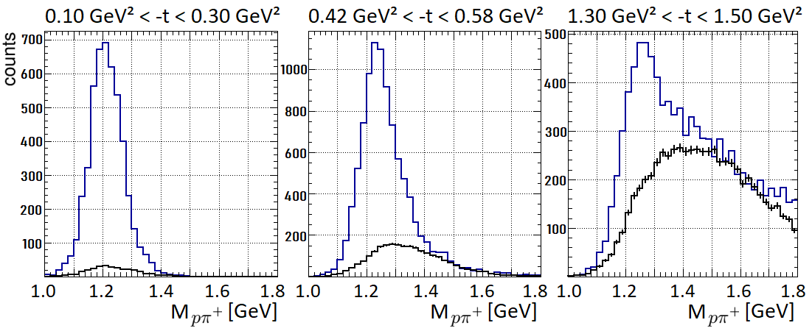
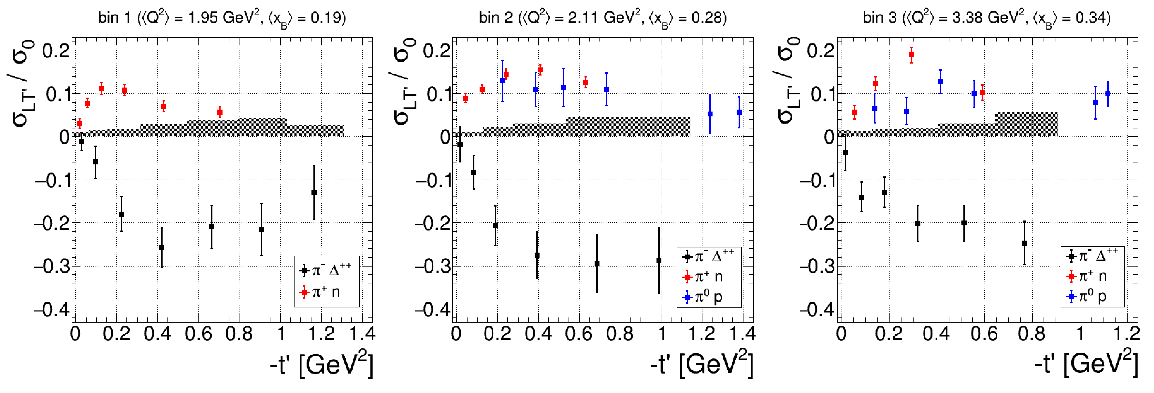
Access to transversity
transition GPDs
Access to the d-quark
content of the nucleon
S. Diehl et al. (CLAS Collaboration),
submitted to Phys. Rev. Lett.
https://doi.org/10.48550/arXiv.2303.11762

