Slide 1
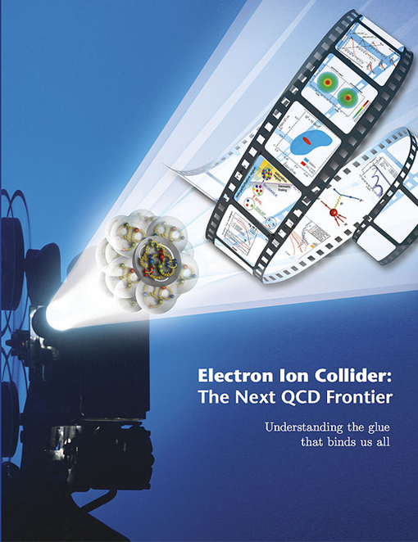
EIC ep Facilities and Program
Thomas K Hemmick
Stony Brook University
Special Thanks for Slides:
E.C. Aschenauer, K. Dehmelt, A. Deshpande, J. Huang, P. Nadel-Turonski

Slide 2

What Physics do You See?

Slide 3
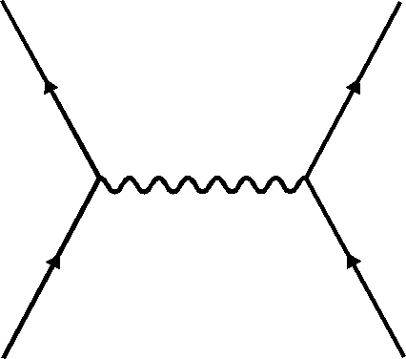
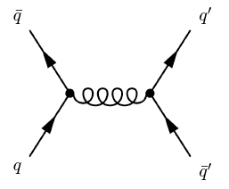
You don’t use pQED to explain water.
The water droplets on the window demonstrate a principle.
Truly beautiful physics is expressed in systems whose underlying physics is QED.
QCD has a frontier because it also has a beautiful structure:
  Phases of QCD matter.
  Hadron structure.
  Spin structure

Slide 4
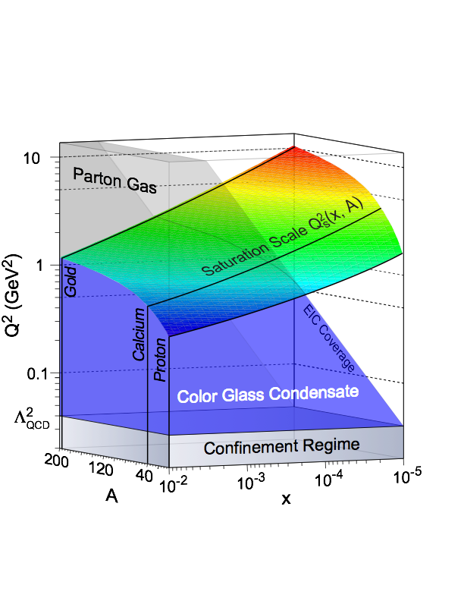

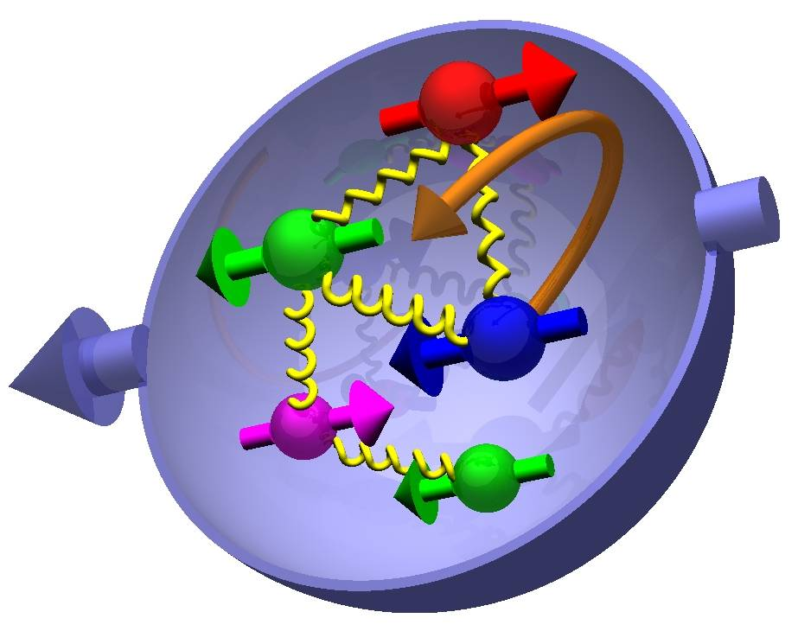
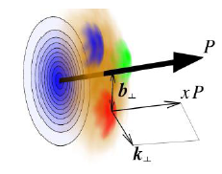
Most Compelling EIC SCIENCE Questions
Where does the saturation of gluon densities set in?
Is there a simple boundary that separates the region from the more dilute quark gluon matter? If so how do the distributions of quarks and gluons change as one crosses the boundary?
Does this saturation produce matter of universal properties in
the nucleon and all nuclei viewed at nearly the speed of light?
How does the nuclear environment affect the distribution
of quarks and gluons and their interaction in nuclei?
How does the transverse spatial distribution of gluons compare to that in the nucleon?
How does matter respond to fast moving color charge passing through it?
Is this response different for light and heavy quarks?
γ*
h
e’
q
e
How are sea quarks and gluons and their spin distributed
in space and momentum inside the nucleon?
How are these quark and gluon distributions correlated with the
over all nucleon properties, such as spin direction?
What is the role of the motion of sea quarks and gluons
in building the nucleon spin?

Slide 5
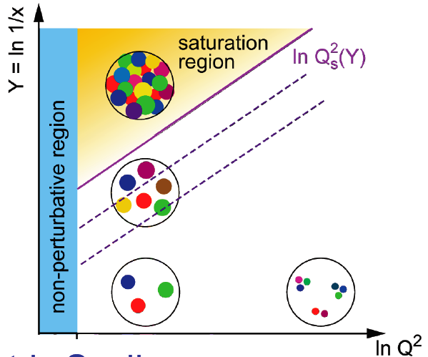
Physics at Low x?
See Ann. Rev. Nucl Part (60) 2010 F. Gelis et al., , arXiv:1002.0333)
Method of including non-linear effects (McLerran, Venugopalan)
Small coupling, high gluon densities
BK/JMWLK equations lead to a Saturation Scale Q_{S}(Y)
BK/JMWLK
Linear QCD
BFKL:
gluon
emission
Nonlinear QCD
BK/JMWLK gluon recombination
BFKL
DGLAP
Need a higher energy e-p collider than HERA!
Large Hadron electron Collider (LHeC)
➔ Nuclei: naturally enhance the densities of partonic matter
Why not use Nuclear DIS at high energy?
At Q_{S} gluon emission balances the recombination
Strongly correlated gluonic system at high energy (low-x)
Universal? Color Glass Condensate ??

Slide 6
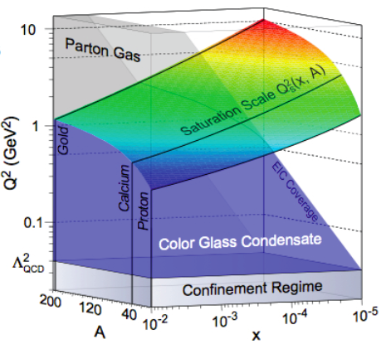
How to reach the high gluon density?
More powerful e-p collider than HERA (300 GeV) → Large Hadron electron Collider
Alternatively,
Probe the nucleons in NUCLEI US Electron Ion Collider (EIC)
Kowalski, Teany
PRD 68:114005
Enhancement of Q_{S} with A, not energy

Slide 7
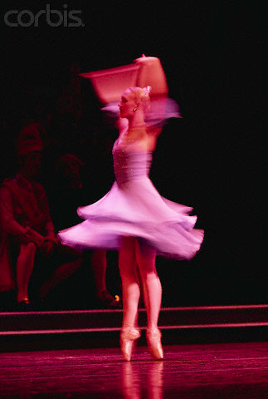

Evolution In Our Understanding Of Nucleon “Spin”
Traditionally we treated proton as a 1D object → What are the quark, gluon intrinsic spin contributions to the nucleon’s spin?
Last 10+ years: Theoretical tools and experiments to view proton as a (2+1)D object became available.
What are the position & momentum correlations amongst partons? Do they contribute to nucleon’s spin?
Notes:
Its not just understanding the nucleon spin sum rule. But a deeper quest to understand the nucleon as a many body object in QCD.

Slide 8
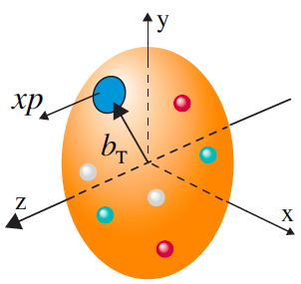
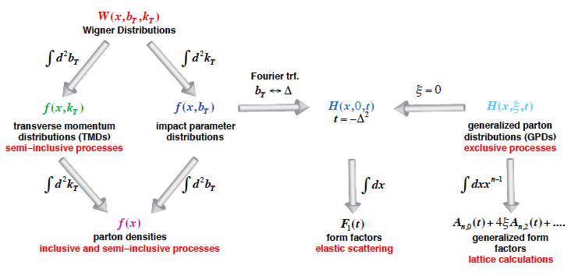
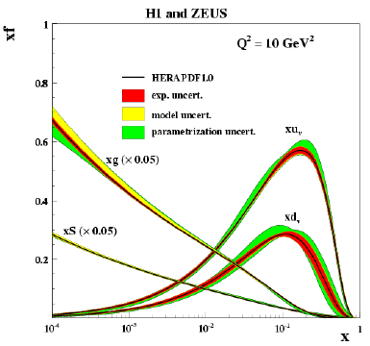
Unified view of the Nucleon Structure
Wigner distributions:
(X. Ji, D. Mueller, A. Radyushkin)
5D
JLab12
COMPASS
for
Valence
HERMES
JLab12
COMPASS
3D
1D
EIC – 3D imaging of partons: Quarks (fixed target) , Gluons (collider)
TMDs – confined motion in a nucleon (semi-inclusive DIS)
GPDs – Spatial imaging of quarks and gluons (exclusive DIS)

Slide 9
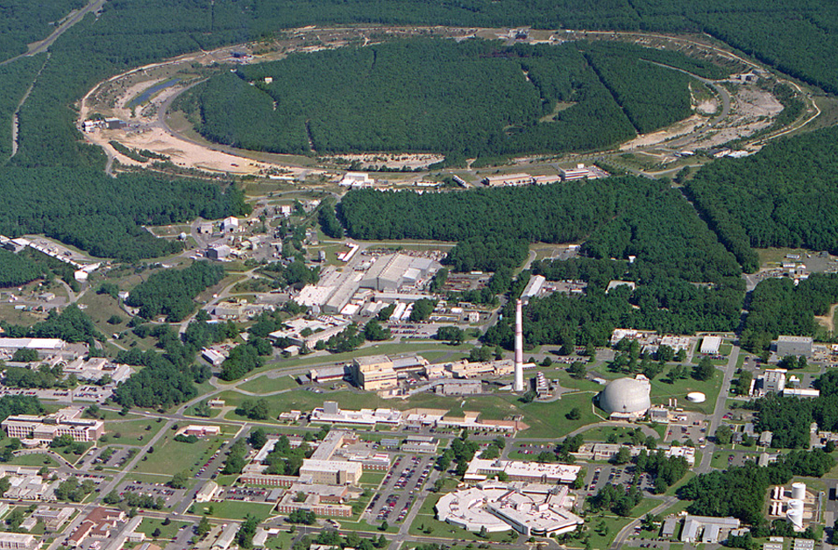
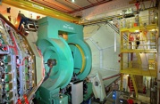
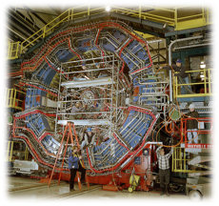
RHIC @ Brookhaven National Lab
1st Collisions: 13/06/2000
Jet/C-Polarimeters
12:00 o’clock
RHIC
CeC-TF
2:00 o’clock
PHENIX
8:00 o’clock
RF
4:00 o’clock
STAR
6:00 o’clock
What do we collide ?
LINAC
NSRL
EBIS
Booster
ERL Test Facility
Polarized protons
24-250 GeV
p
AGS
Light ions (d,Si,Cu)
Heavy ions (Au,U)
5-100 GeV/u
Tandems
soon
Polarized light ions He³ 16 – 166 GeV/u

Slide 10
From RHIC to eRHIC
eLenses
10:00 o’clock
Jet/C-Polarimeters
12:00 o’clock
eRHIC-Detector
& Polarimeters
12:00 o’clock
CeC
2:00 o’clock
RHIC
eRHIC
e
PHENIX
8:00 o’clock
RF
4:00 o’clock
e
STAR
6:00 o’clock
LINAC
NSRL
EBIS
Booster
ERL Test Facility
AGS
Tandems

Slide 11
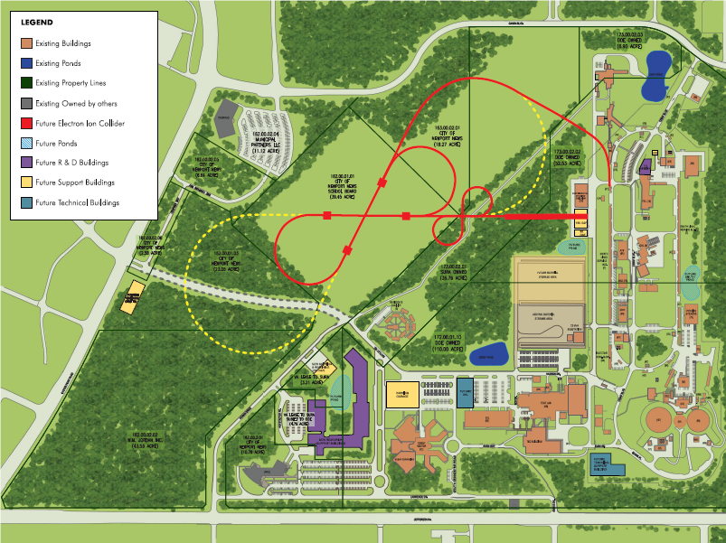
The EIC at Jefferson Lab
e injection
Hall D
M E I C
(Stage-I EIC)
IP2
Ion linac
IP1
Pre-booster
C E B A F
High-Energy Ring (Stage-II EIC)
Halls A-C
The MEIC has a circumference similar to CEBAF (1.4 km)

Slide 12
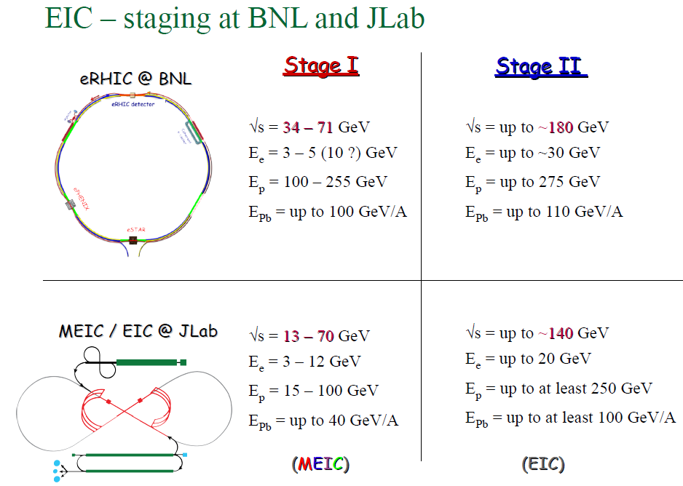

Slide 13


Electron beam evolution in eRHIC’s ERL
0.60 GeV
0.6 GeV
Polarized
e-gun
0.6 GeV
Beam
dump
27.55 GeV
New
detector
Linac 2.45 GeV
Coherent e-cooler
3.05 GeV
Linac 2.45 GeV
5.50 GeV
7.95 GeV
10.4 GeV
12.85 GeV
15.3 GeV
17.75 GeV
20.2 GeV
22.65 GeV
25.1 GeV
27.55 GeV
30 GeV
30.0 GeV
ePHENIX
100 m
ERL:
energy recovery linac
eSTAR
30 GeV
Animation is by N. Tsoupas

Slide 14
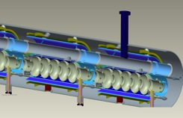
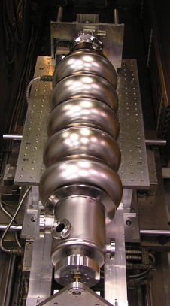

Staging of eRHIC: E_{e}: 5 to 30 GeV
0.02 Eo
All energies scale proportionally by adding SRF cavities to the injector
Polarized
e-gun
0.6 GeV
Beam
dump
27.55 GeV
New
detector
Linac
E/Eo
0.0200
0.1017
0.1833
0.2650
0.3467
0.4283
0.5100
0.5917
0.6733
0.7550
0.8367
0.9183
1.0000
Coherent e-cooler
0.9183 Eo
Linac 2.45 GeV
Eo
0.8367 Eo
0.7550 Eo
0.6733 Eo
0.5917 Eo
0.5100 Eo
0.4286 Eo
0.3467 Eo
0.2650 Eo
0.1017 Eo
0.1833 Eo
30 GeV
All magnets would installed from the day one and we would be cranking power supplies up as energy is increasing
ePHENIX
100 m
eSTAR
30 GeV
Notes:
We returned to developing cost effective and ECO-friendly eRHIC option with ERL located in the existing RHIC tunnel. We plan to install all magnets for 6 passes and 30 GeV from the start and then build up SRF linac from 1 GeV to 5 GeV per pass.
In this case electrons will pass through the detector halls in the way to the top energy, will collide in up to 3 IRs. Then they will be decelerated to the injection energy and damped.

Slide 15
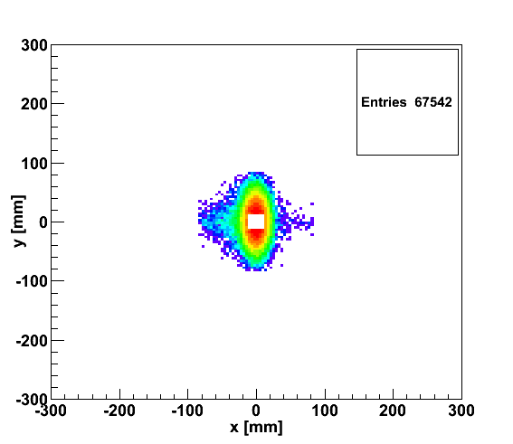
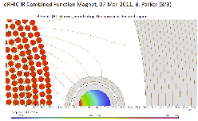
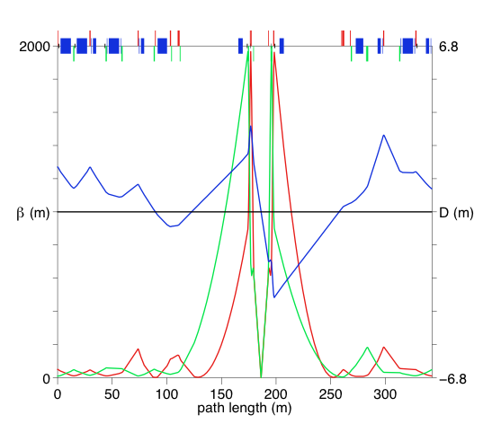
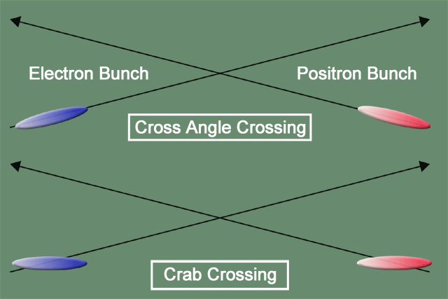
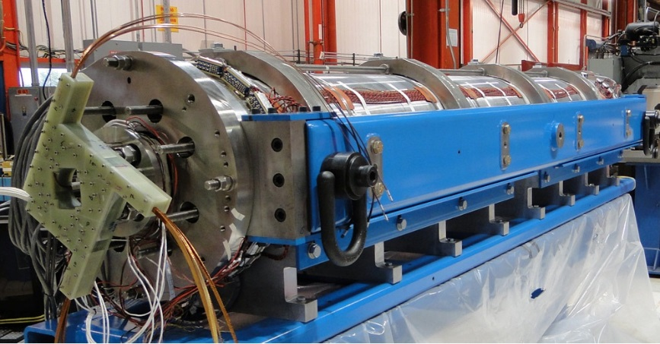
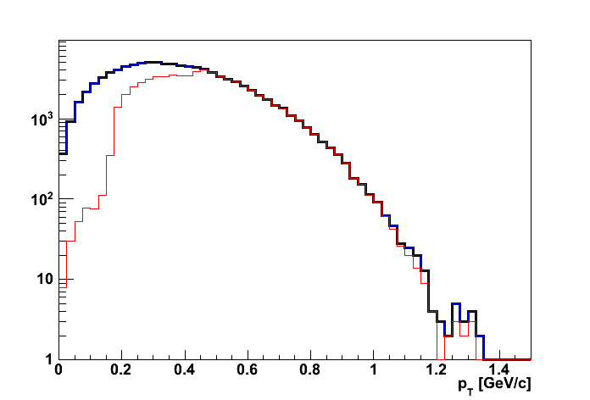
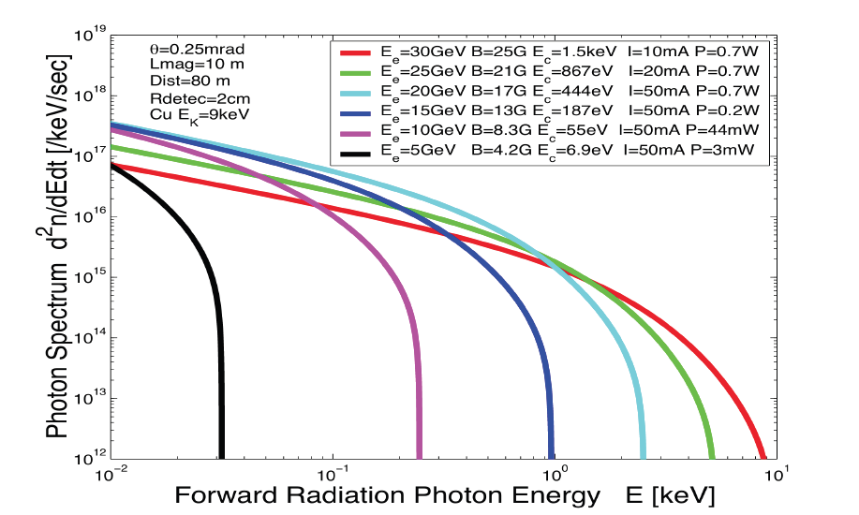
eRHIC: high-luminosity IR
20x250
p
Proton beam lattice
G.Ambrosio et al., IPAC’10
e
Nb₃Sn
20x250
200 T/m
eRHIC - Geometry high-lumi IR with β*=5 cm, l*=4.5 m
and 10 mrad crossing angle → 10³⁴ cm⁻² s⁻¹
Generated
Quad aperture limited
RP (at 20m) accepted
10 mrad crossing angle and crab-crossing
High gradient (200 T/m) large aperture Nb₃Sn focusing magnets
Arranged free-field electron pass through the hadron triplet magnets
Integration with the detector: efficient separation and registration of low angle collision products
Gentle bending of the electrons to avoid SR impact in the detector
© D.Trbojevic, B.Parker, S. Tepikian, J. Beebe-Wang

Slide 16
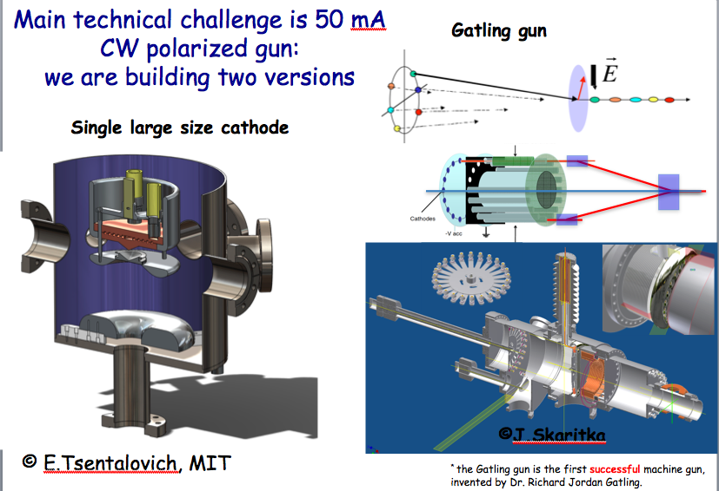
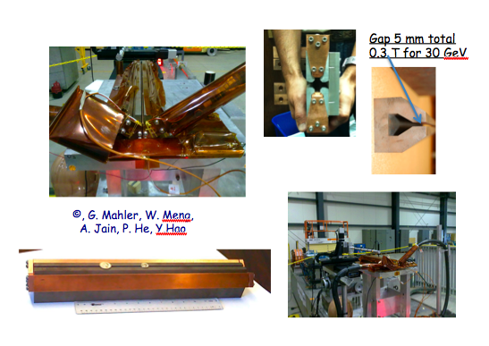
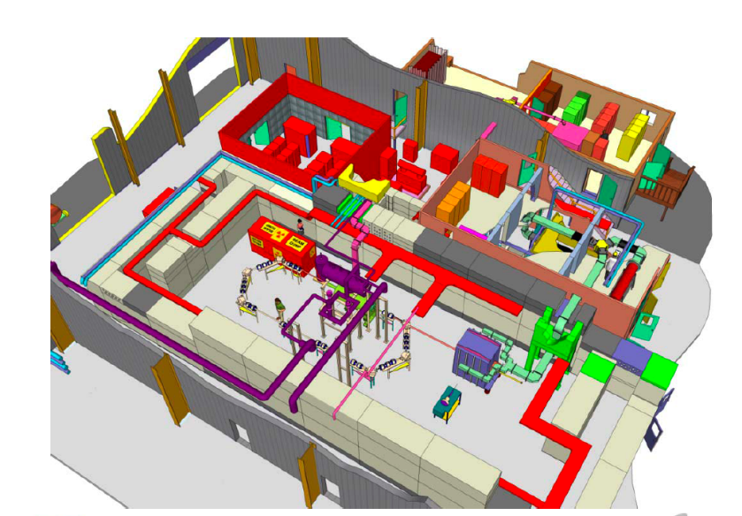
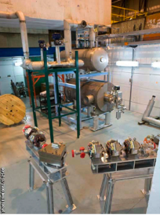
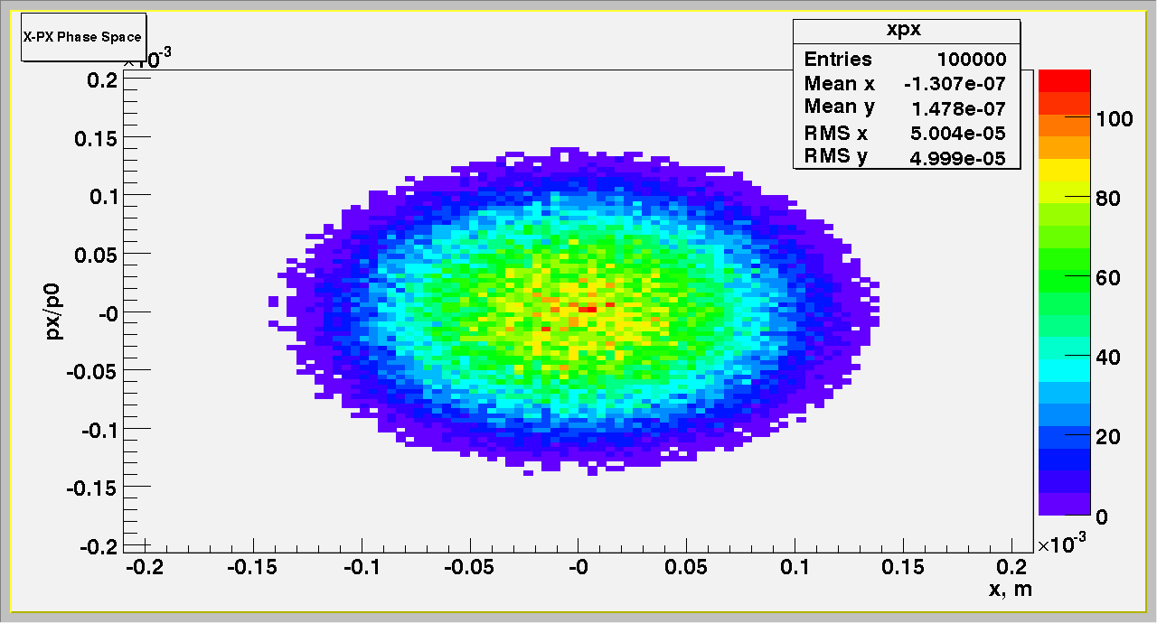
eRHIC R&D highlights
Polarized gun for e-p program – LDRD at BNL + MIT
→ prototype under construction
Development of compact magnets - LDRD at BNL → first prototyes
SRF R&D ERL – TF ongoing
Beam-beam effects, beam disruption, kink instability suppression, etc.
Polarized He³ source - Workshop: https://indico.bnl.gov/conferenceDisplay.py?confId=405
Coherent Electron Cooling: TF for PoP by ~2016
Challenge | Increase/reduction beyond the state of the art
Polarized electron gun | 10 x increase
Coherent Electron Cooling | New concept
Multi-pass SRF ERL | 5 x increase in current 30 x increase in energy
Crab crossing | New for hadron colliders
Understanding beam-beam effects | New type of collider
β*=5 cm | 5x reduction
Multi-pass SRF ERL | 2-3 x in # of passes
Feedback for kink instability suppression | Novel concept
Space charge effect compensation | Novel concept

Slide 17
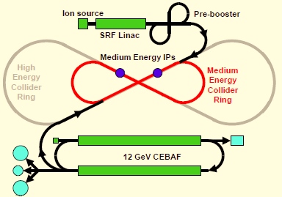
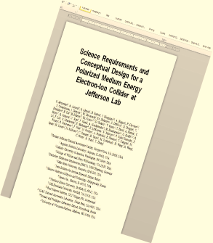
MEIC – design goals
EIC
MEIC
MEIC
Spin control for all light ions
(arXiv:1209.0757)
Figure-8 layout
No Siberian Snakes needed for polarization.
Full-acceptance detector
Stable concept – detailed design report released August 2012
Ring designed around detector requirements
Full acceptance for small (low Q²) angles.
Minimized technical risk

Slide 18
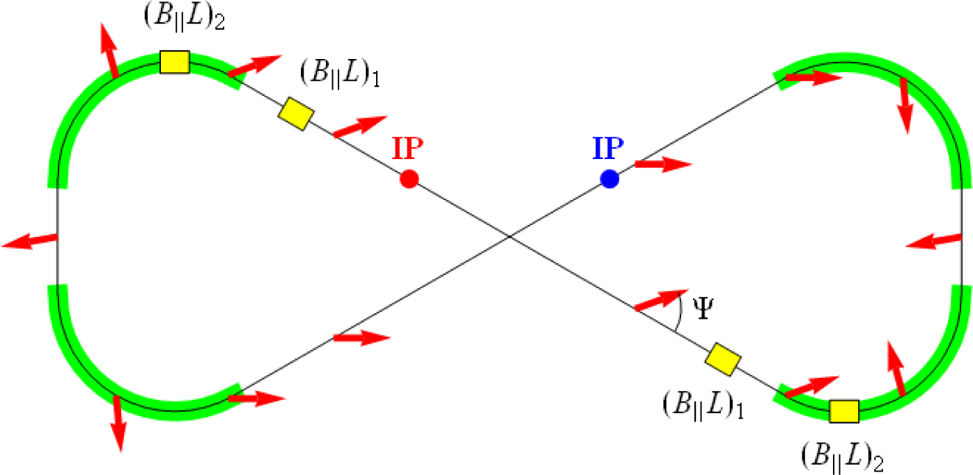
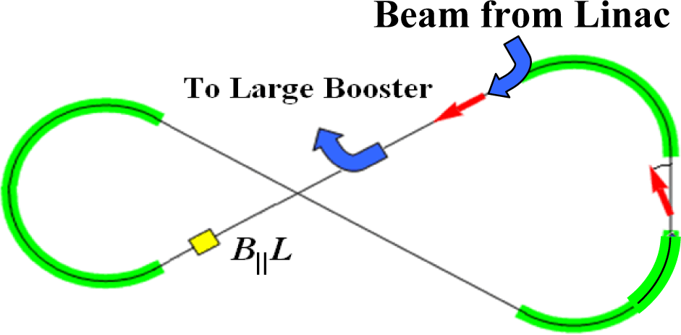
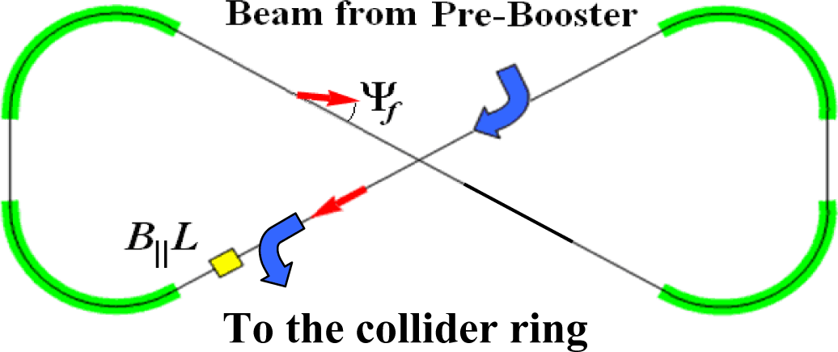
MEIC – ion polarization in figure-8 ring
Science program demands highly polarized (>70%) light ion beams (p, D, ³He, Li, ...)
Figure-8 shape used for all ion booster and collider rings
  Spin precession in one arc is canceled by the other arc
  No preferred periodic spin direction
  Energy-independent spin tune
  Simplified polarization control and preservation for all ion species
  Needs only small magnetic fields (instead of Siberian Snakes) to control polarization at Ips
  The electron ring has a figure-8 shape because it shares a tunnel with the ion ring
  Figure-8 ring is the only practical way to accelerate polarized deuterons
Large
booster
Pre-Booster
Ion Collider Ring

Slide 19
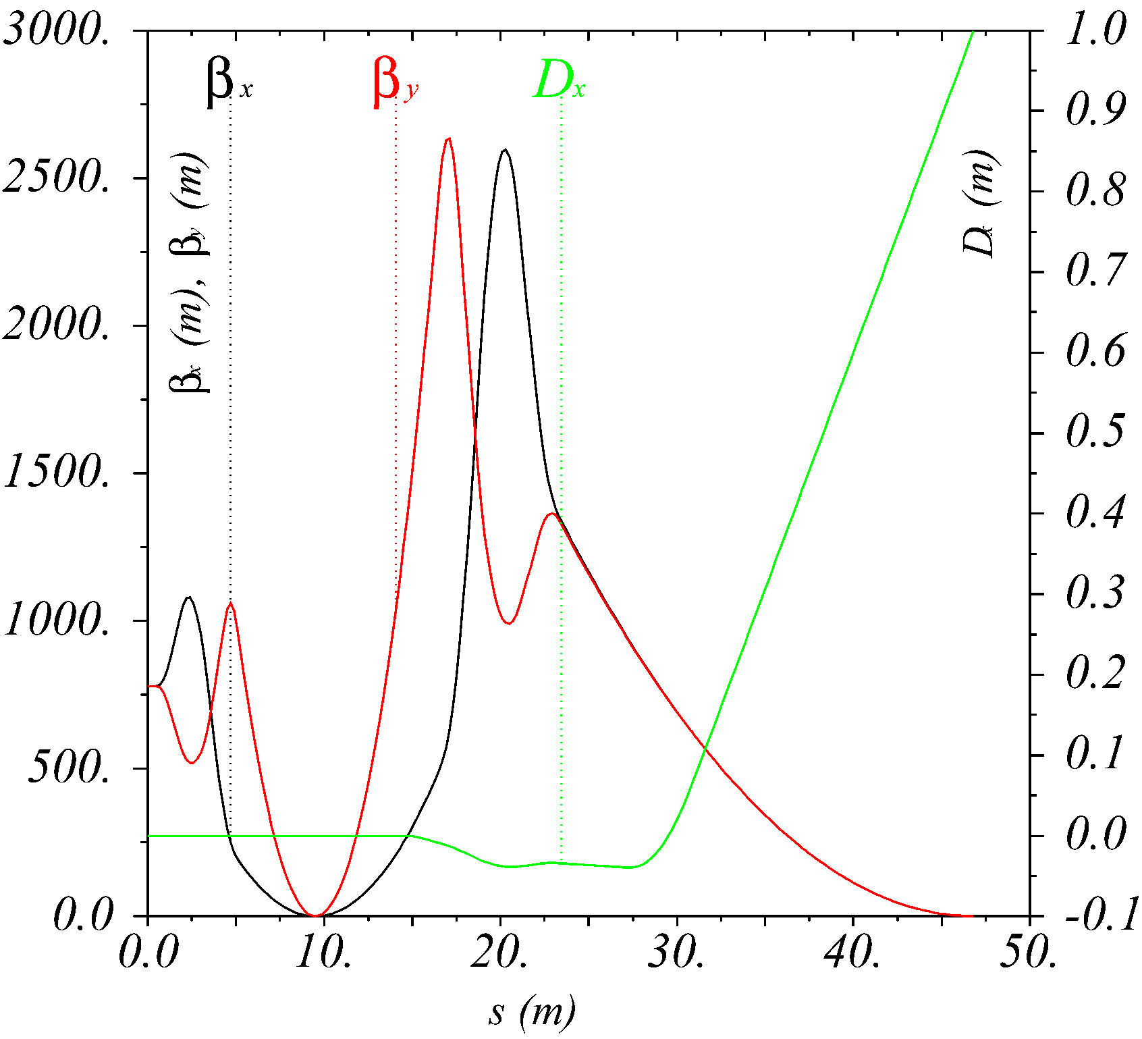
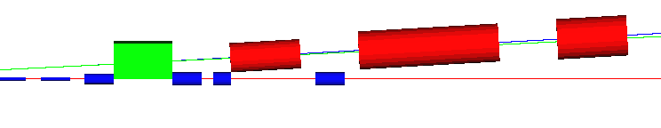
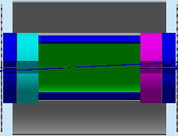
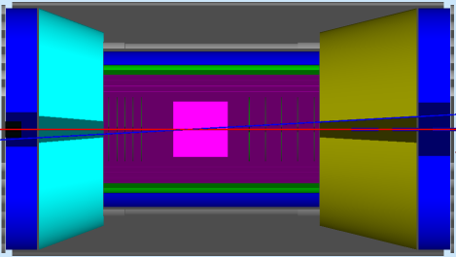
The full-acceptance detector concept
No other magnets or apertures between IP and FP!
Endcap
1 m
1 m
Ion quadrupoles
2 Tm dipole
Electron quadrupoles
Trackers and “donut” calorimeter
small angle
hadron detection
(from GEANT4)
IP
FP
ultra forward
hadron detection
low-Q²
electron detection
n, γ
large aperture
electron quads
ion quads
~60 mrad bend
p
small diameter
electron quads
e
p
50 mrad beam
(crab) crossing angle
Thin exit windows
Fixed trackers in vacuum?
Roman pots
central detector
with endcaps
Forward hadron detection in three stages:
1. Endcap with 50 mrad crossing angle
2. Small dipole covering angles up to a few degrees
3. Ultra-forward, up to one degree, for particles passing the accelerator quads

Slide 20
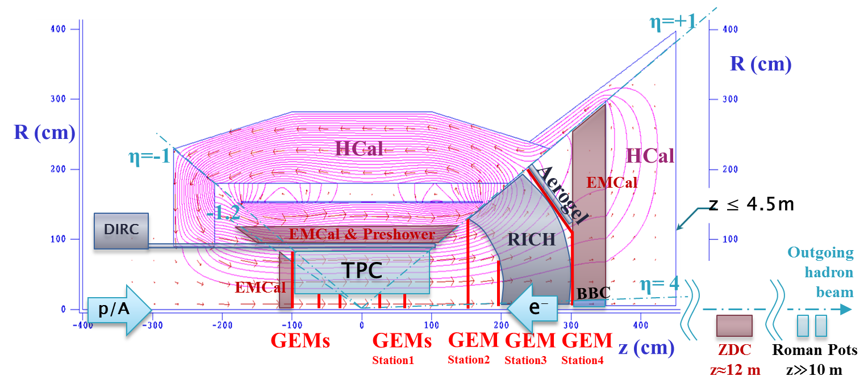
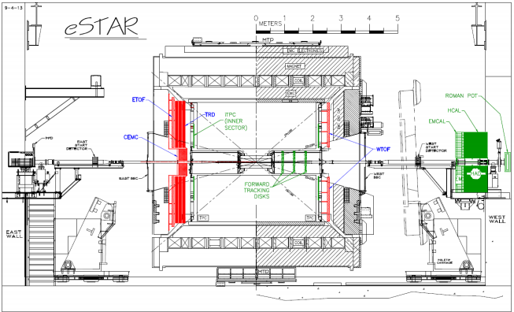
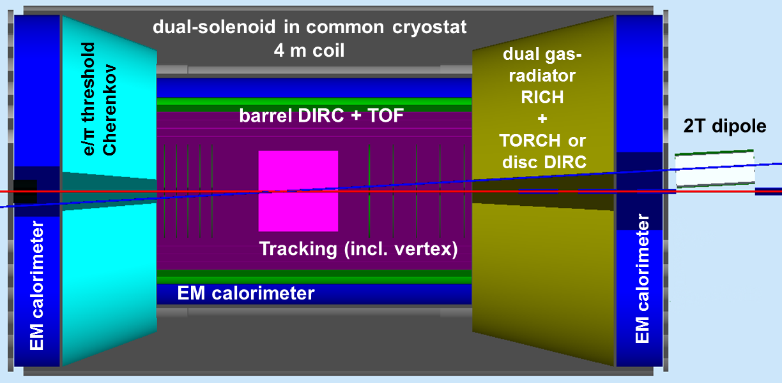
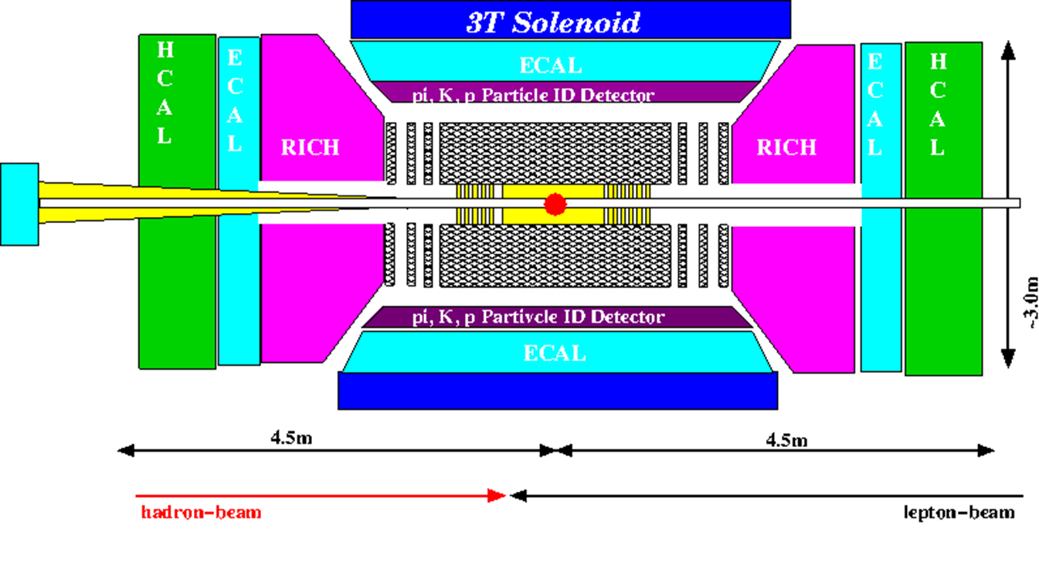
Four Detector Designs

Slide 21
Detector Designs – to scale

Slide 22
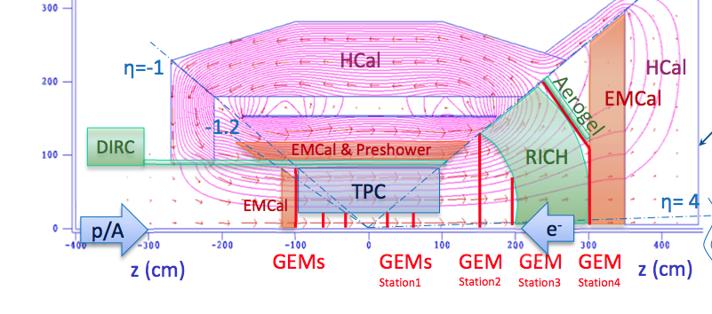
ePHENIX: Example Detector Concept
fsPHENIX definition:
  sPHENIX with hadron endcap
  Adds GEM-tracking, RICH, Aerogel, addn’l ecal & hcal.
  Leaves sPHENIX barrel unchanged.
ePHENIX definition:
  fsPHENIX with electron endcap
  Removes silicon tracking
  Adds crystal emcal, TPC, DIRC.

Slide 23







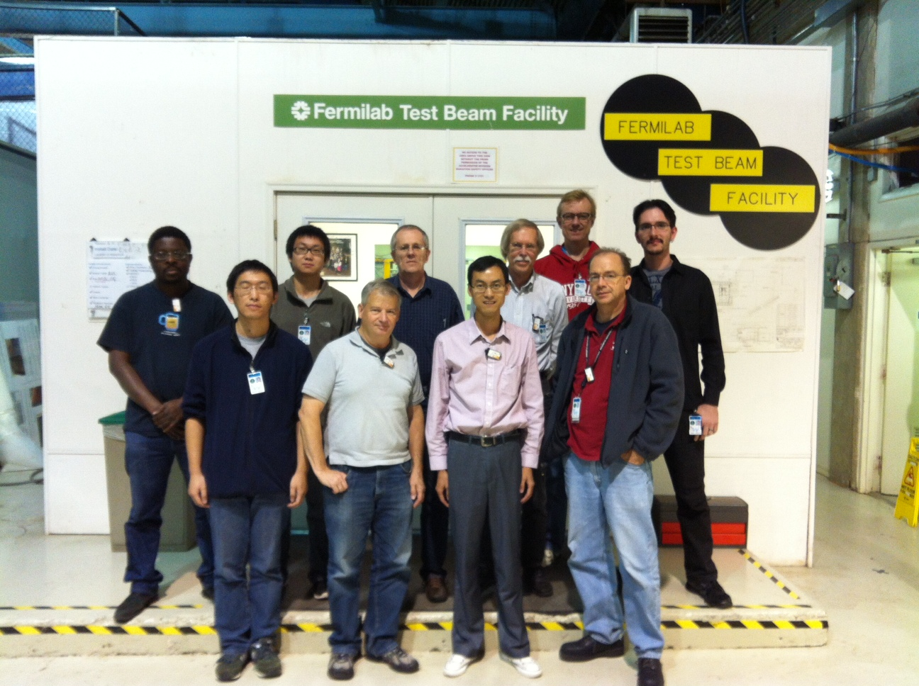
EIC Tracking Consortium @ Fermilab:
October 1, 2013 – October 23, 2013
Shift Crew 1
BNL
Florida Tech
Stony Brook University
University of Virginia
Yale University
Shift Crew 2
Current Effort: Forward Hadron Arm.
Future Effort:
Central TPC

Slide 24
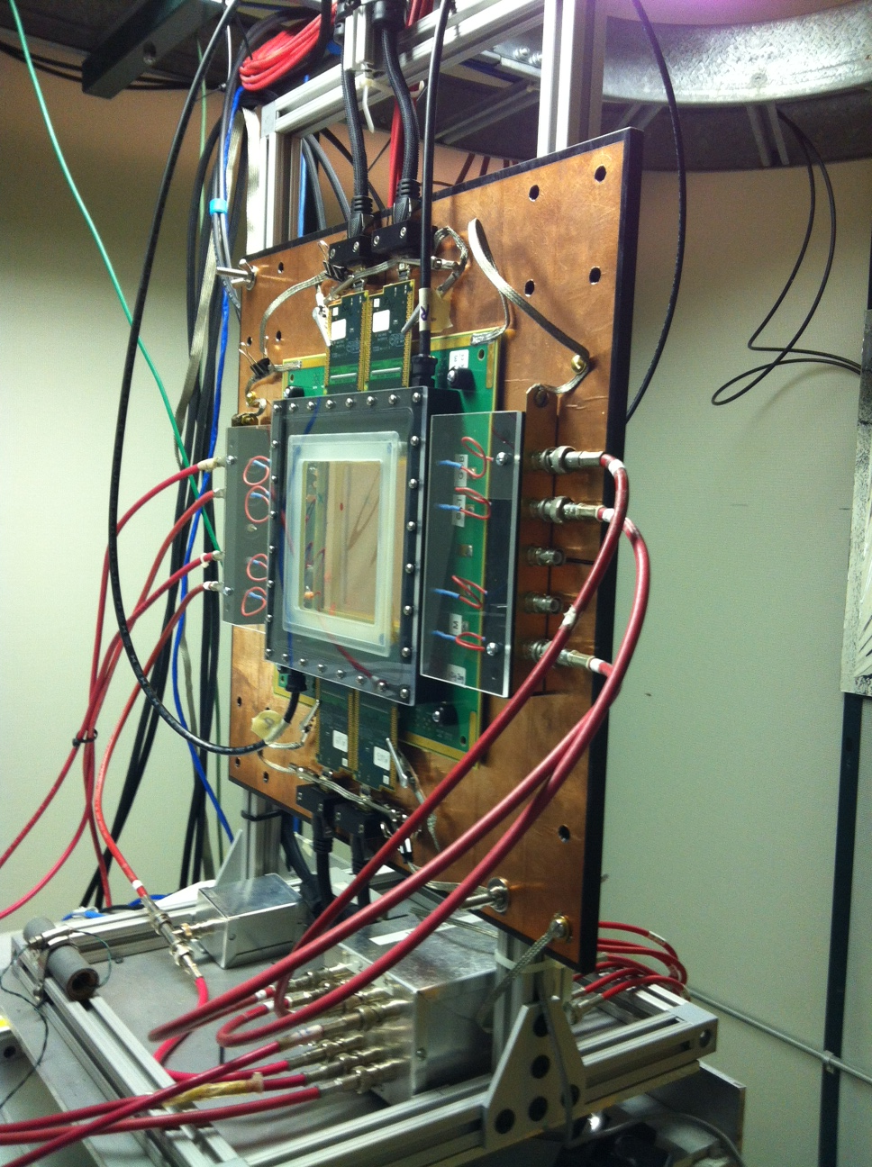
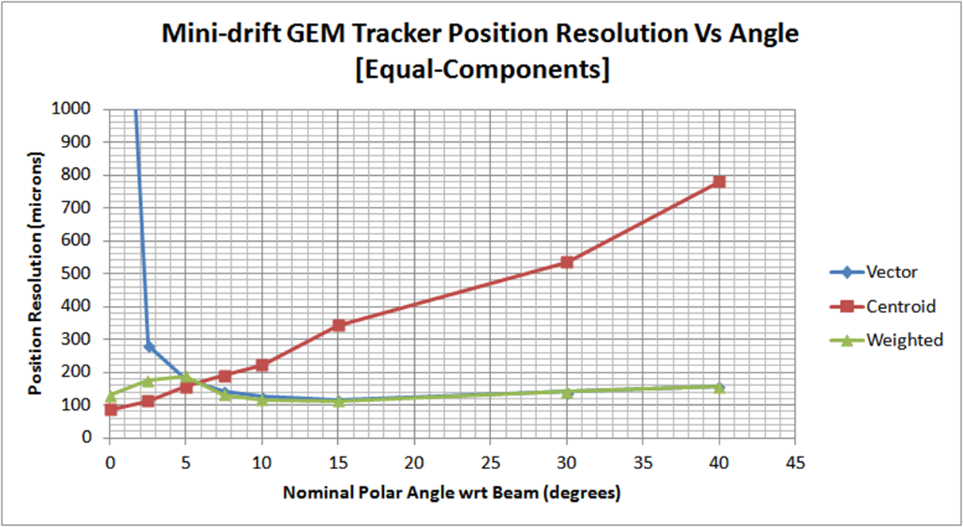
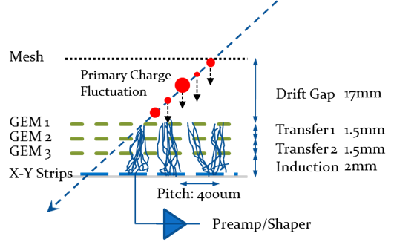
MT6 1A – Minidrift GEM chamber
BNL
Challenge:
Standard GEM tracking chambers have their resolution deteriorate with non-normal incidence.
Approach:
Raising the grid above the first GEM allows each chamber to measure a vector to correct for the inclination of every track.

Slide 25
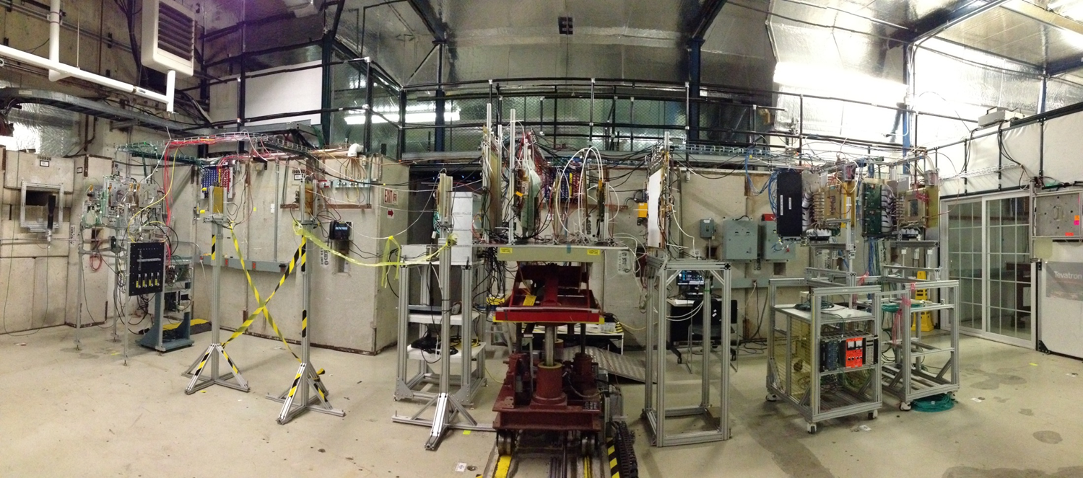
MT6 2A and 2B
University of Virginia
Yale University
Florida Institute of Technology
Extensive setup of trackers at station 2B
Testing new readout schemes.
Testing largest area GEM detectors built in the US.

Slide 26



MT6-2A 3-coordinate readout
Standard Cartesian Readout
- ”Compass Style”
- XY Hit Matching by Charge
New 3-coordinate Readout
-Hit matching: GEOMETRY & CHARGE
Challenge:
Cartesian Readouts can lead to ambiguities in X-Y associations for high multiplicity events.
Solution:
3 coordinate readout made on double-sided kapton.

Slide 27



Large Area Tracking Chambers
Challenge:
GEM detector technology must be expanded in size to be useful in large experiments. Other than at CERN, these are the largest area GEM trackers in the world.
Furthermore:
Alternative Readout using ZigZags.
Status: Working and taking data.

Slide 28




10 Chambers, All working.
Uva SBS1
FIT CMS zz
S4 zz
UVA EIC
Trackers

Slide 29



Gas RICH
R (cm)
η=1
RICH Mirror
RICH Gas
Volume (CF₄)
High momentum hadron ID require gas Cherenkov
  CF₄ gas used, similar to LHC_{b} RICH
Beautiful optics using spherical mirrors
Photon detection using NaI-coated GEM in hadron blind mode
Magnetic field line mostly along track within the RICH volume
→ minor ring smearing due to track bending
Focal plane
HBD detector
η=2
spherical
mirror
center
η=3
Entrance
Window
η=4
IP
Z (cm)
PID purity at η=4 (most challenging region)
Purity

Slide 30



Short Radiator RICH
O₂ 1.66ppm
H₂O 0.08ppm
Standard GEM
Challenge:
Hadron (pion, kaon, proton) ID at high lab momentum requires the Cherenkov effect. Typical long radiator lengths (e.g. 3 meters CF₄ in LHCb) make experiments large/costly.
Solution:
CsI photocathode RICH allows operation in DEEP UV (down to 120 nm) thereby collecting more light. Further, this photon detection technology is VERY inexpensive per unit area.
Making a GEM Detect Light
CsI

Slide 31





Rings!!
32 GeV Beam Momentum

Slide 32
Summary
The EIC will provide the access to a new frontier:
  High density gluonic matter.
  Spin structure.
  3D nucleon structure.
Competing, capable designs exist for the machine at RHIC or J-Lab.
Vigorous R&D is moving the boundary of what is possible in detector technology.
All are welcome to join!

Slide 33
Backups

Slide 34


Timelines
Similar for both projects; mid 2020’s for first physics runs.

Slide 35


MT6 2A
Rotation Mount Allows
for pitch and yaw scans
Y
X
U
Beam
Event display –
four single plane
3-coordinate GEM Chambers
Single track fires x,u,y in all planes
Working and Collecting Data
Chamber 1
Chamber 2
Pulse Height
Chamber 3
Chamber 4
Readout Channel

Slide 36

Beam Spot

Slide 37




JLab 12 GeV upgrade – probing the valence quarks
New Hall
Upgrade arc magnets
and supplies
Add 5 cryomodules
20 cryomodules
CHL upgrade
Add arc
20 cryomodules
Add 5 cryomodules
The completion of the 12 GeV Upgrade of CEBAF was ranked the highest priority in the 2007 NSAC Long Range Plan.
Enhanced capabilities
in existing Halls
Scope of the project includes:
Doubling the accelerator beam energy
New experimental Hall and beamline
Upgrades to existing Experimental Halls
New C100 cryomodules in linac tunnel

Slide 38


Slide 39


Slide 40


Slide 41


Slide 42


Slide 43


Slide 44
A fully integrated interaction region
IP
(top view)
forward e⁻
detection
forward ion
detection
ions
e⁻ spin rotator
e⁻
final focusing
elements
v-step and
50 mrad crossing
Recoil baryon detection:
IR optics
Small beam size (β) and large dispersion at the secondary focal point give superb resolution and acceptance at very small angles
Focal Point:
D ~ 1 m
β ~ 1 m
Excellent t-coverage for all kinematics!
IP
FP

Slide 45


Ultra-forward hadron detection
Neutron detection in a 25 mrad cone down to zero degrees
Excellent acceptance for all ion fragments
Recoil baryon acceptance:
  up to 99.5% of beam energy for all angles
  down to at least 2-3 mrad for all momenta
Momentum resolution < 3x10⁻⁴
  15 MeV for a 50 GeV/A tagged deuteron beam
n
2 Tm dipole
20 Tm dipole
p
solenoid
e

Slide 46



PHENIX Evolution
Current PHENIX
sPHENIX
ePHENIX
Central barrel detector
Talk: CG.00004 Eric Mannel
Forward detector
Talk: CG.00003 Cesar da Silva
Physics:
A. Bazilevsky’s talk
Detector :
This talk
~2000
~2020
~2025
Time

Slide 47





γ*
h
e’
q
e
ePHENIX is designed to be a comprehensive EIC detector
A upgrade path that harvest pp, pA physics before EIC era
  Central barrel upgrade : Session CG - Eric Mannel - The sPHENIX Upgrade
  End-cap upgrade : Session CG - Cesar L. da Silva - The forward sPHENIX detector design and its physics program

Slide 48


ePHENIX Detector Concept
-4<η<-1 (e-going) :
Crystal calorimeter + GEM trackers
-1<η<+1 (barrel) : sPHENIX + Compact-TPC + DIRC
+1<η<+4 (h-going) :
  1<η<4 : GEM tracker + Gas RICH
  1<η<2 : Aerogel RICH
  1<η<5 : EM Calorimeter + Hadron Calorimeter
Cost: sPHENIX MIE + 75M$ (including overhead + contingency)
ePHENIX Δg projection
See: A. Bazilevsky’s talk
η=+1
R (cm)
R (cm)
η=-1
HCal
HCal
Aerogel
EMCal
-1.2
z ≤ 4.5m
DIRC
EMCal & Preshower
RICH
Outgoing
hadron
beam
TPC
EMCal
η= 4
p/A
e⁻
BBC
GEMs
GEMs
Station1
GEM
Station2
GEM
Station3
GEM
Station4
z (cm)
ZDC
z≈12 m
Roman Pots
z≫10 m

Slide 49


BaBar Magnet
BaBar superconducting magnet
  Built by Ansaldo → SLAC ~1999
  Nominal field: 1.5T
  Radius : 140-173 cm
  Length: 385 cm
Ownership officially transferred to BNL
Field calculation and yoke tuning
  Three field calculator cross checked: POISSION, FEM and OPERA
Favor for ePHENIX tracking
  Designed for homogeneous B-field in central tracking
  Longer field volume for forward tracking
  Higher current density at end of the magnet -> better forward bending
  Work well with RICH in ePHENIX yoke: Forward & central Hcal + Steel lampshade
BaBar solenoid packed for shipping, May 17 2013
Longer Magnet
Babar
Tracking resolution based on field calculation
Babar magnet VS longer MIE sPHENIX magnet

Slide 50


Tracking system
GEM
Good momentum resolution over wide range, -3<η<+4
GEM tracker for forward region
  d(rφ) = 100 μm; 50 μm for very forward region
GEM-based TPC for barrel region
  10μs max drift time and no-gate needed
  Thin support structure using fibre-reinforced polymer
LEGS-TPC, Geronimo, 2005
LEGS: Laser Electron Gamma Source @ BNL
Main detector:
Driving factor:
e-going GEM
Electron ID
TPC
Kinematic
h-going GEM
Hadron PID
dp/p~1%×p
Additional dp/p term:
dp/p≲3% for 1<η<3
dp/p~10% for η=4
dp/p~0.1%×p

Slide 51





Calorimeters
More detail: CG.00002 John Haggerty
Electron purity after EMCal PID
EM Calorimeter
  Measure electrons and photons
  e-going: PbWO₄ crystal calorimeter, dE/E~1.5%/√E
  Barrel and h-going: W- and Pb-scint. sampling calorimeter, dE/E~12%/√E
Hadron Calorimeter
  Cover -1<η<+5, great for ID diffractive events
  Also serve as magnetic field return
ID diffractive events using ePHENIX calorimeters
η of most forward going particle
Eff./Purity with η_{MAX} cut

Slide 52



Hadron PID Overview
Aerogel RICH
1<η<2
DIRC
-1.2<η<+1
Gas RICH
1<η<4
Detector coverage for hadron PID
TPC
GEMs
e⁻
p
eGEM
IP
RICH
Mirror
Hadron PID Coverage
SIDIS x-Q² coverage with hadron PID in two z-bins
DIRC
  Based on BaBar DIRC design plus compact readout
  Collaborate with TPC dE/dx for hadron ID in central barrel
Aerogel RICH
  Approximate focusing design as proposed by Belle-II
  Collaborate with gas RICH to cover 1<η<2
Gas RICH: next slides

Slide 53

Full simulation is on-going
An event display for SIDIS @ x≈5×10⁻³ and Q²=10 (GeV/c)²
Integrated in PHENIX software framework
Hadron Calo.
Aerogel
Babar coil
EM Calo.
EM Calo.
Gas RICH
Hadron Calo.
DIRC
TPC
GEMs
e⁻, 10 GeV/c
DIS e⁻
p, 250 GeV/c
IP
BBC
EMCal

Slide 54

Electron-Ion Collider
eRHIC @ BNL
MEIC @ J-Lab
“The Next QCD Frontier”
Physics:
  Matter at high gluon density
  Nucleon spin
  Spatial Parton Distributions
T-1037 is funded by the
Site-neutral R&D Program administered @ BNL

